Slide 1
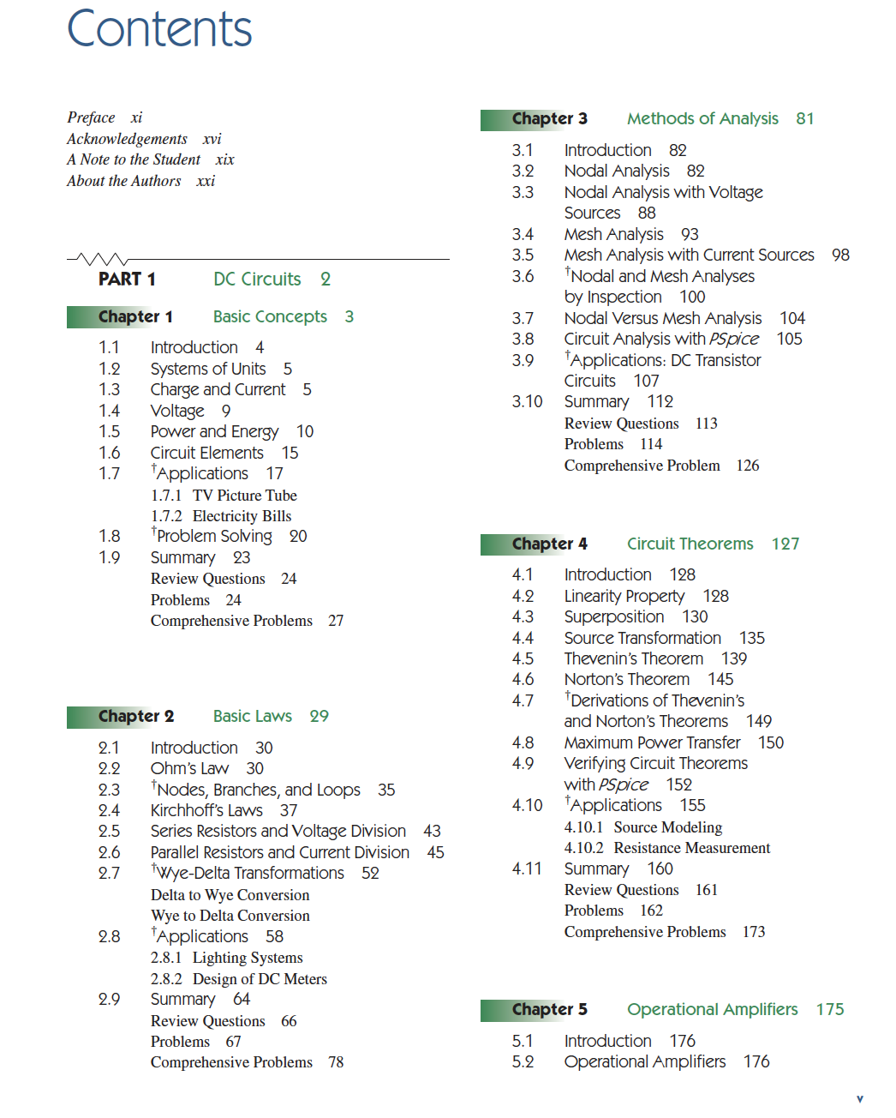

Slide 2
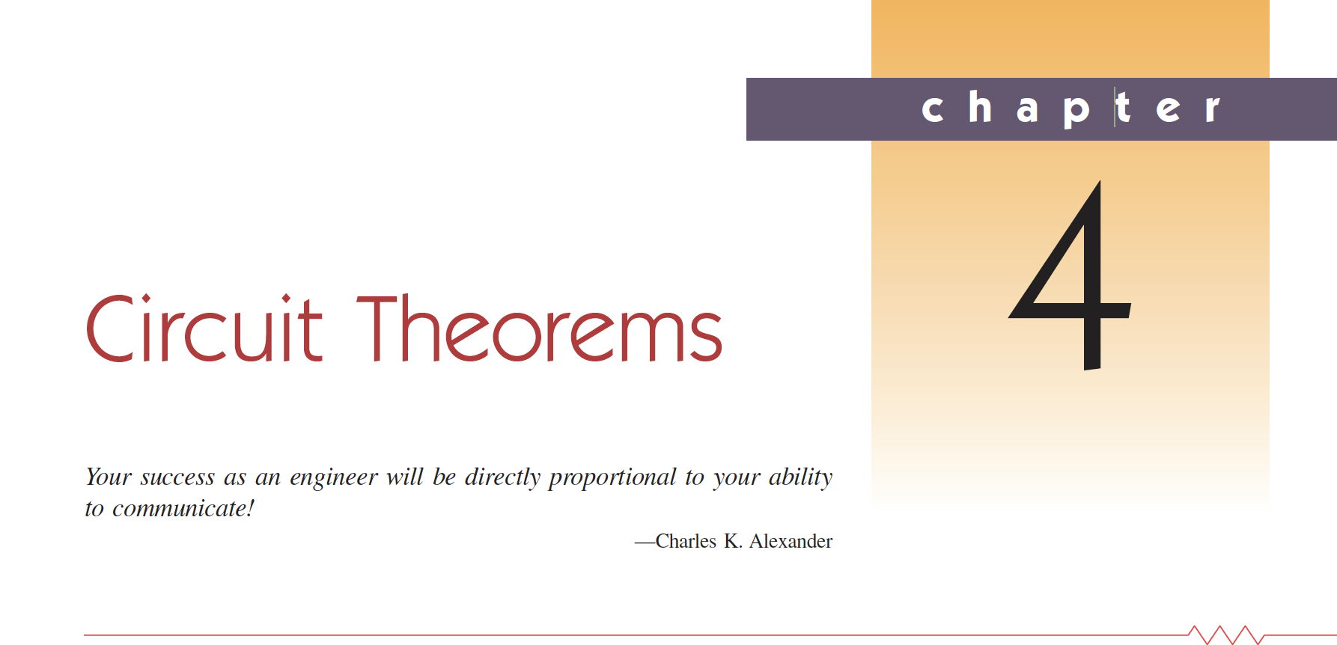

Slide 3
4.1 Giriş
Until know we used Kirchhoff’s laws without changing the circuit network.
In order to simplify complex networks, there are some theorems (Thevenin and Norton theorems)
These theorems only applicable to linear circuits.

Slide 4
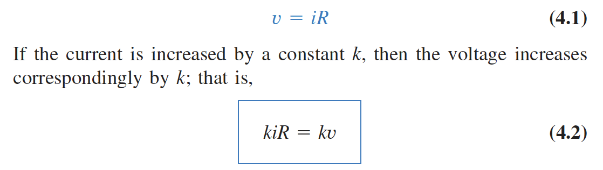
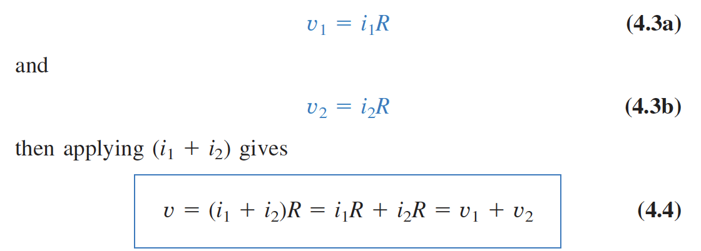
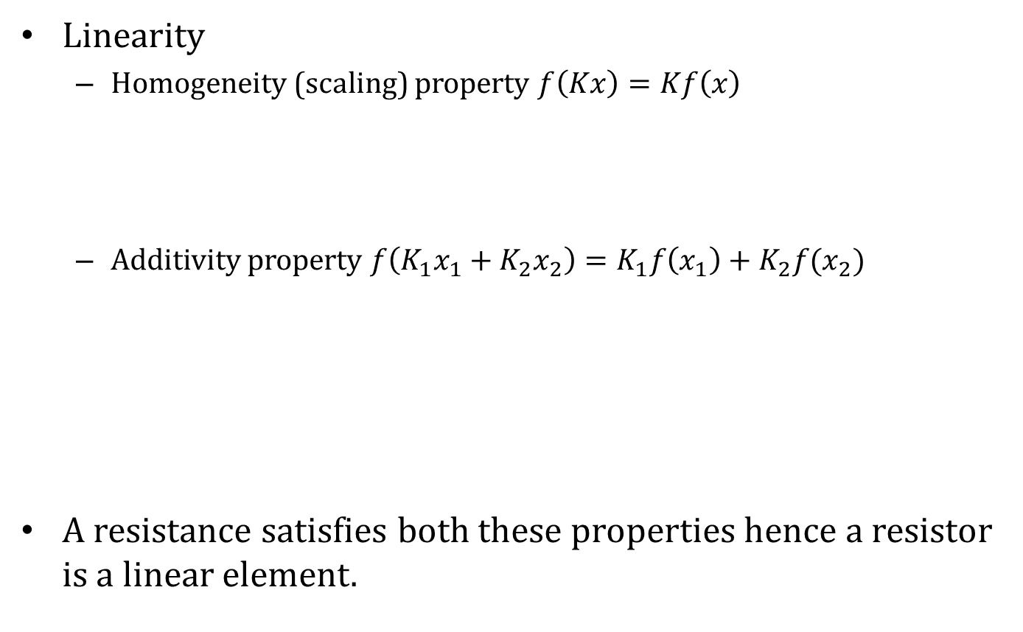
4.2 Doğrusallık Özelliği
Linearity
  Homogeneity (scaling) property $f\left(Kx\right)=Kf\left(x\right)$
  Additivity property $f\left(K_{1}x_{1}+K_{2}x_{2}\right)=K_{1}f\left(x_{1}\right)+K_{2}f(x_{2})$
A resistance satisfies both these properties hence a resistor is a linear element.

Slide 5
4.2 Doğrusallık Özelliği
Linearity
  Homogeneity (scaling) property
  Additivity property
Current, voltage resistance relation is linear but power relation is not.

Slide 6
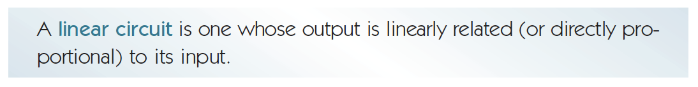
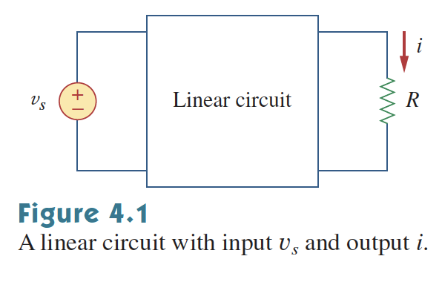
4.2 Doğrusallık Özelliği

Slide 7
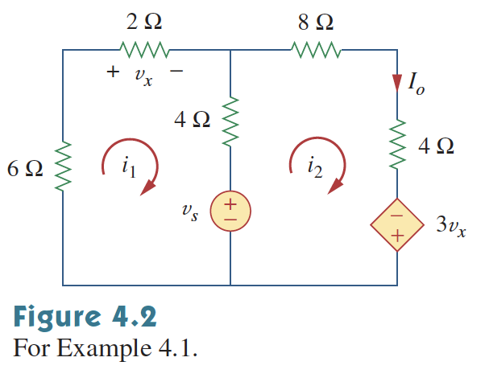
4.2 Doğrusallık Özelliği

Slide 8
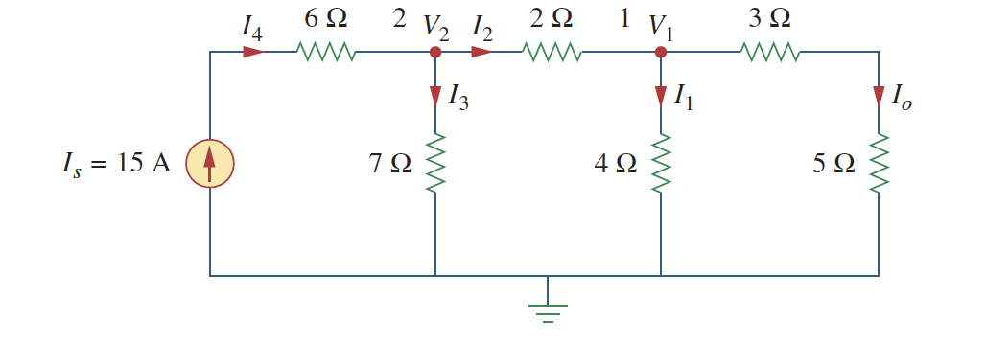
4.2 Doğrusallık Özelliği
(Unit Output Method – Birim çıktı yöntemi)

Slide 9
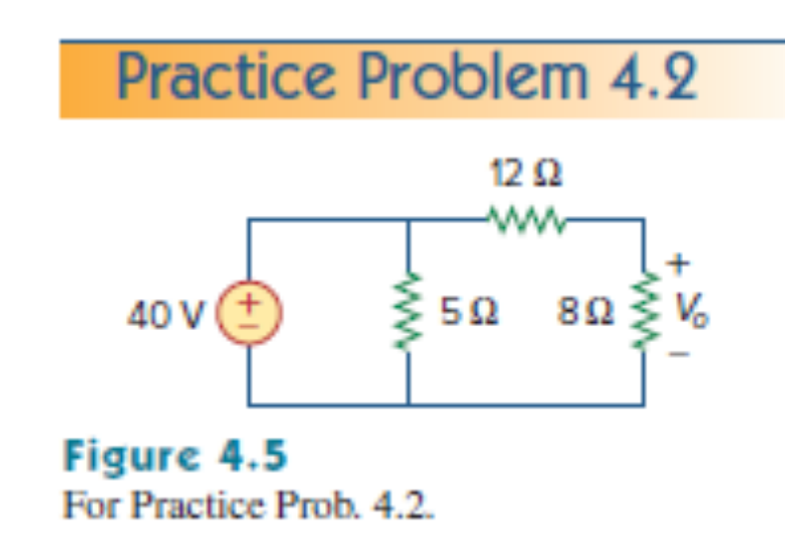
4.2 Doğrusallık Özelliği

Slide 10
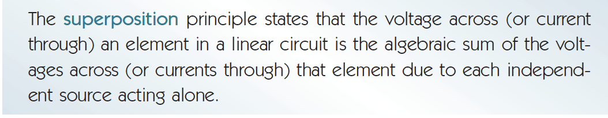
4.3 Superpozisyon
Keep in mind only independent sources are turned off.

Slide 11
4.3 Superpozisyon
Step by step
  Identify all of the independent sources in the circuit.
  Choose one source that will remain active. Deactivate all of the others. (Remove current sources, leaving open circuits. Replace voltage sources with short circuits.)
  Using whatever techniques are appropriate, solve for the desired quantity (current or voltage) in the circuit. This will be a “partial” result, due only to the one active source in the circuit.
  Return to the original circuit. Choose a different source to remain active and deactivate all of the others.
  Solve again for the desired quantity, which will be a second partial result.
  Continue in this manner, working sequentially through each of the sources in the circuit, finding a partial result for each.
  Add together all of the partial results to obtain the total result corresponding to all of the sources working simultaneously in the circuit.

Slide 12
4.3 Superpozisyon
Cautions in using superposition
  Superposition only works with linear circuits. (Linear circuits contain only sources, resistors, capacitors, inductors, linear amplifiers, etc.) Most electronic devices (diodes and transistors) are non-linear, so superposition will not be applicable.
  Because the method relies on linearity, you cannot add powers directly using the superposition method. (Power goes as v2 or i2 – it is not linear.) Use superposition to find the total current or voltage and then calculate power from that result.
  When finding the partial solutions, be sure to maintain the same voltage polarity and current direction in each case. For example, one source may induce the current in a particular resistor to flow in one direction while another source causes to a current flowing in the opposite direction. You must keep the proper signs when adding to the partial results to obtain the correct total result.

Slide 13
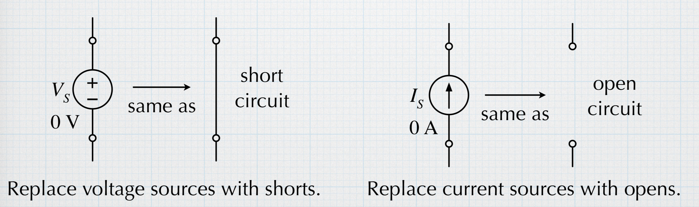
4.3 Superpozisyon

Slide 14
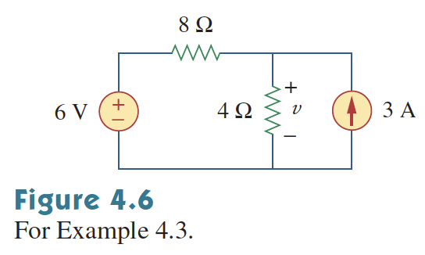
4.3 Superpozisyon

Slide 15
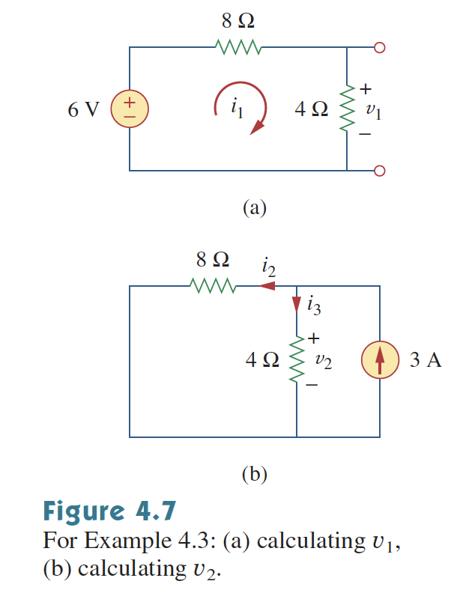
4.3 Superpozisyon

Slide 16
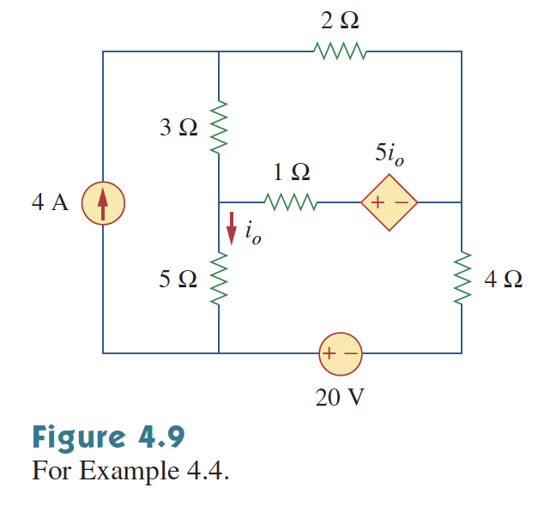
4.3 Superpozisyon

Slide 17
4.3 Superpozisyon

Slide 18
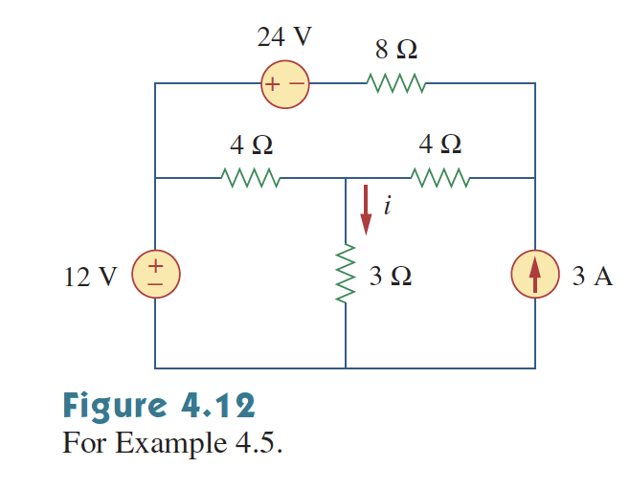
4.3 Superpozisyon

Slide 19
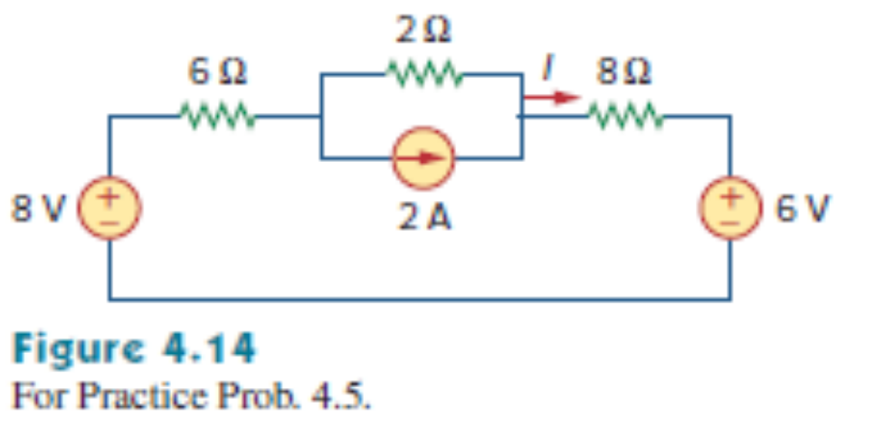
4.3 Superpozisyon

Slide 20
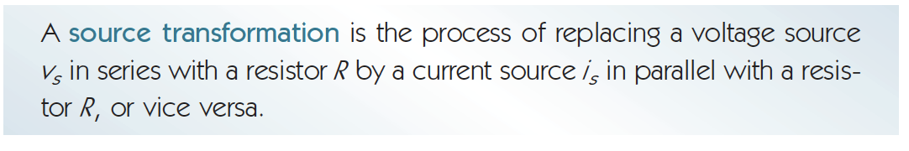
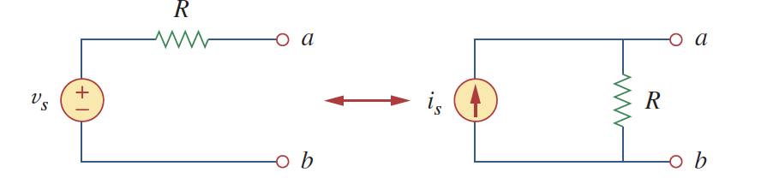
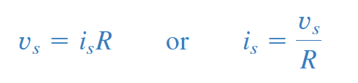
4.4 Kaynak Dönüşümü
Kaynaklar sıfırlandığında a-b noktalarından görülen direnç aynı
Kısa devre yapıldığında a’den b’ye giden akım aynı

Slide 21
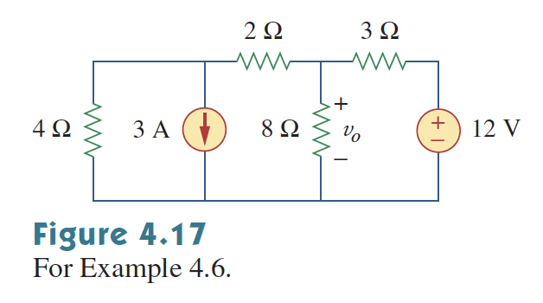
4.4 Kaynak Dönüşümü

Slide 22
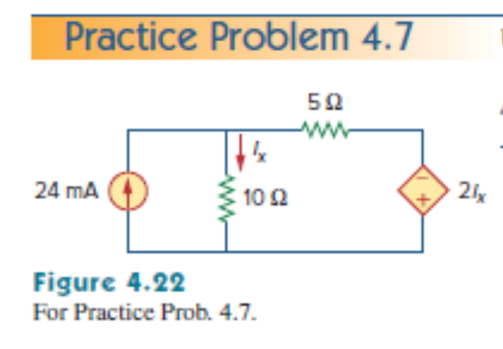
4.3 Superpozisyon

Slide 23
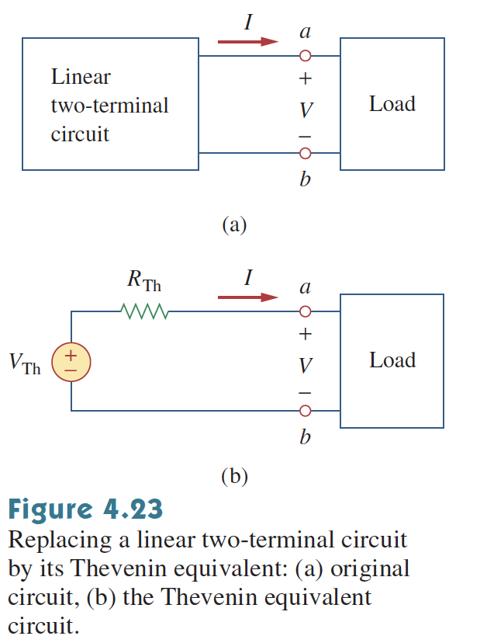
4.5 Thevenin Teoremi
Thevenin’s Theorem states that a two terminal linear circuit can be replaced by a voltage source and resistor.

Slide 24
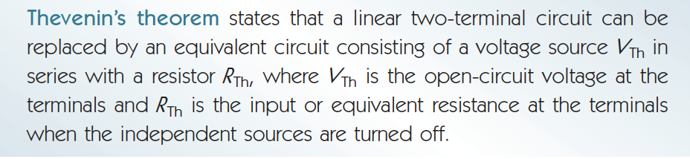
4.5 Thevenin Teoremi

Slide 25
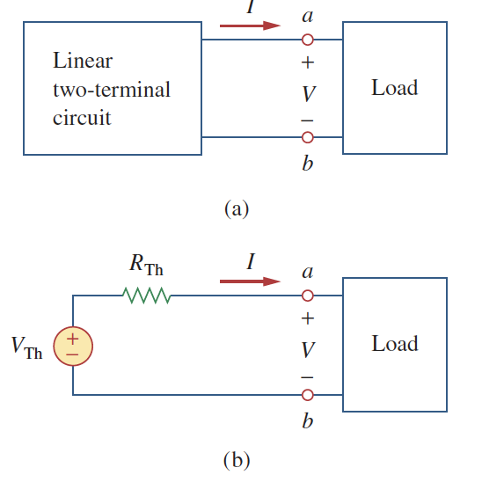
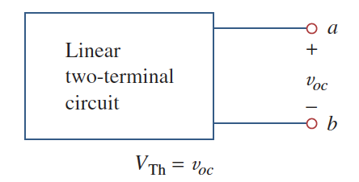
4.5 Thevenin Teoremi
How to find V_{TH} and R_{TH}
  Remove the load find V_{Th}

Slide 26
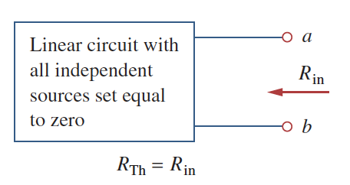
4.5 Thevenin Teoremi
How to find V_{TH} and R_{TH}
  Remove the load and set independent sources zero to find R_{Th}

Slide 27
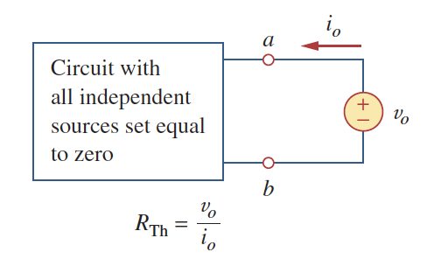
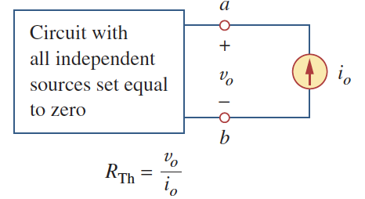
4.5 Thevenin Teoremi
Remove the load and set independent sources zero to find R_{Th}
  if the circuit has dependent sources turn off all the independent sources and apply one the following methods:

Slide 28

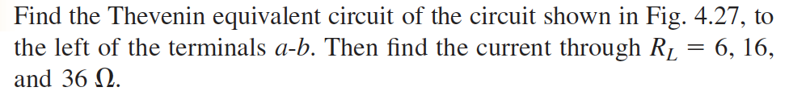
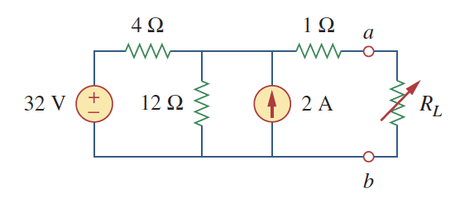
4.5 Thevenin Teoremi

Slide 29
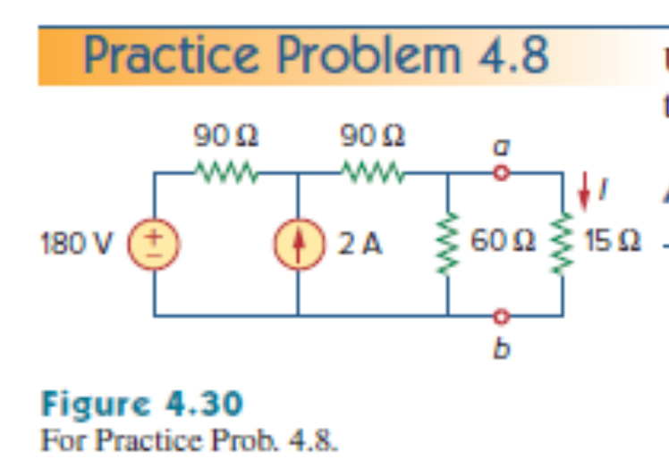
4.5 Thevenin Teoremi

Slide 30
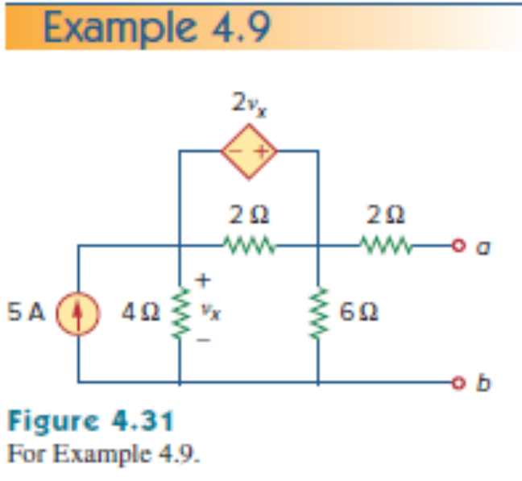
4.5 Thevenin Teoremi

Slide 31
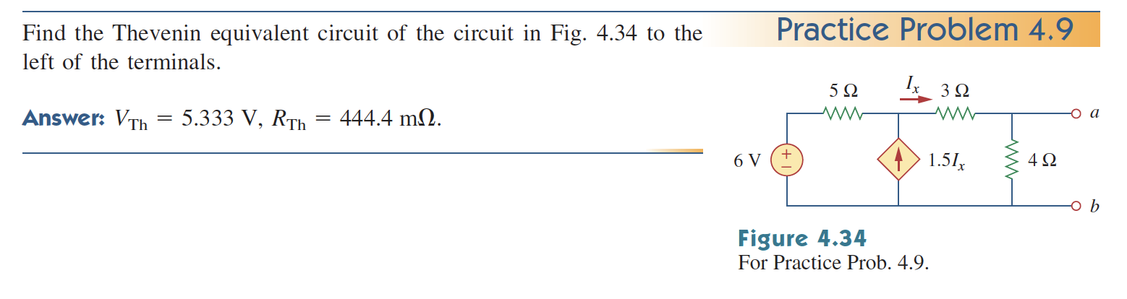
4.5 Thevenin Teoremi

Slide 32
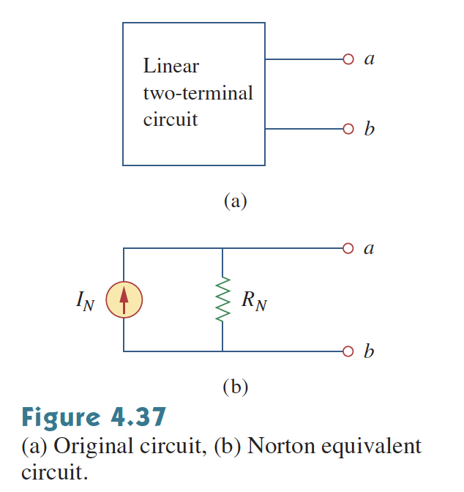
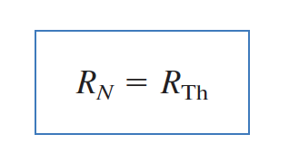
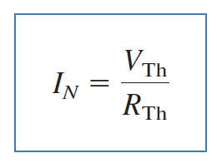
4.6 Norton Teoremi
Norton’s Theorem states that a linear two terminal circuit can be replaced by a current source (I_{N}) in parallel with a resistor (R_{N}).

Slide 33
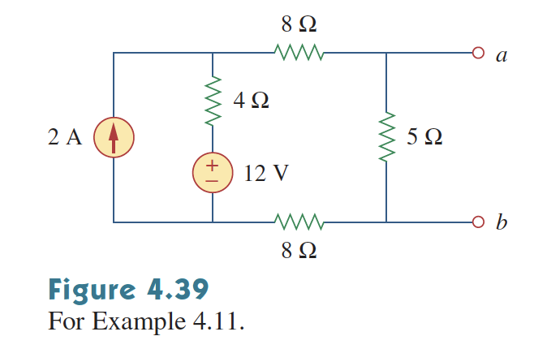
4.6 Norton Teoremi

Slide 34
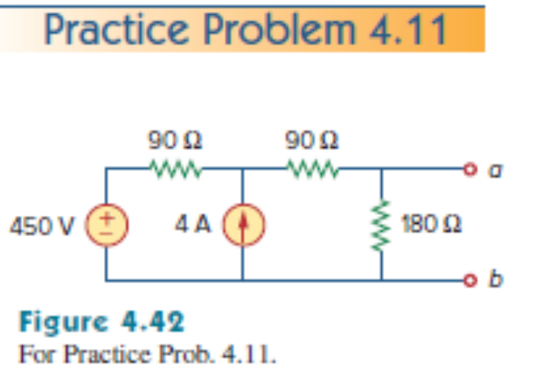
4.6 Norton Teoremi

Slide 35
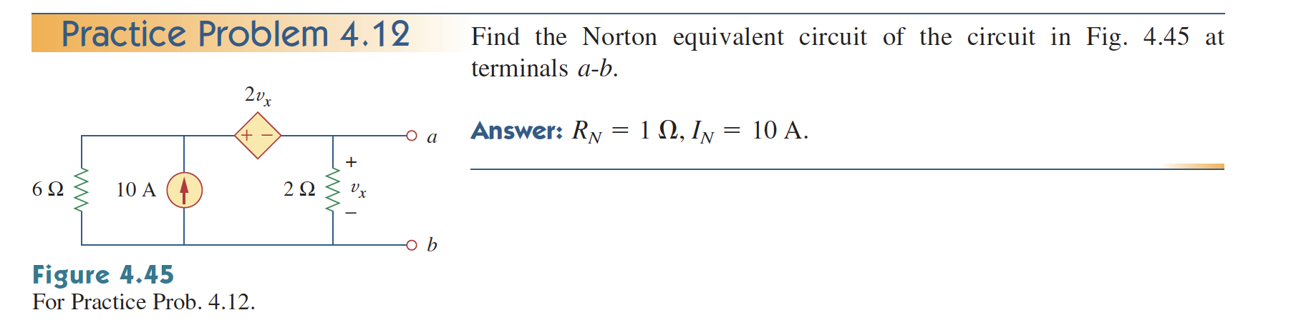
Norton’s Theorem

Slide 36
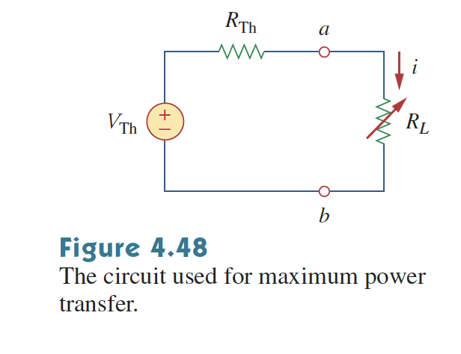
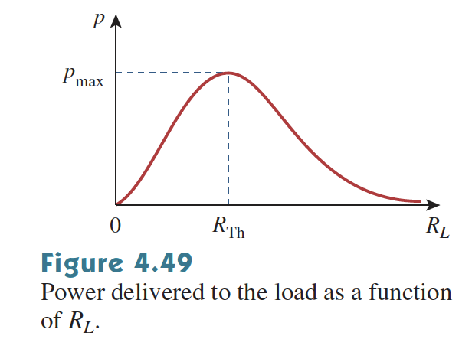
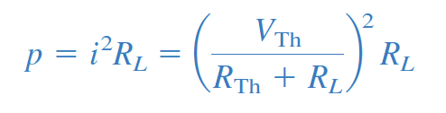
4.8 Güç Aktarımı
In many practical situations a circuit transfers power to a load.

Slide 37
İspat

Slide 38
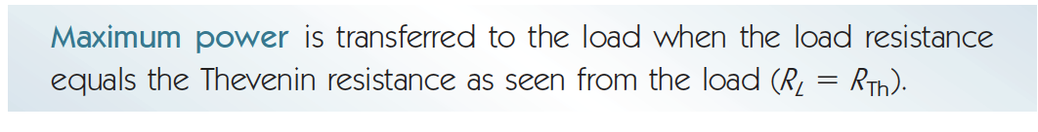
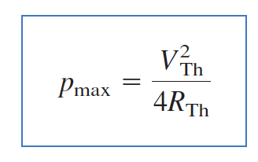
4.8 Güç Aktarımı
For maximum power transfer:

Slide 39
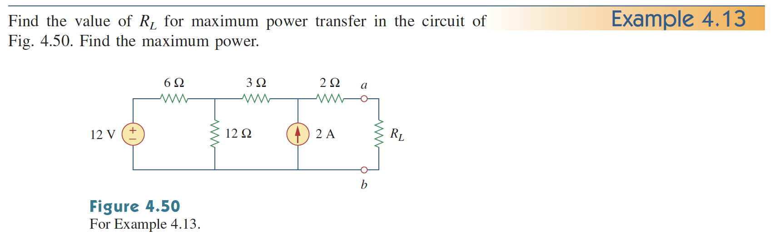
4.8 Güç Aktarımı

Slide 40
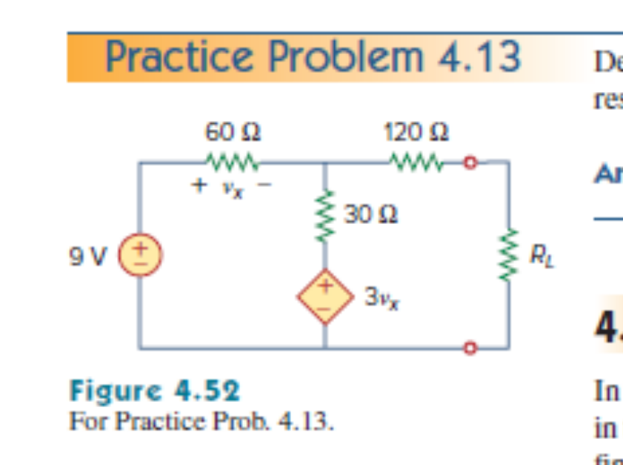
4.8 Güç Aktarımı

Slide 41
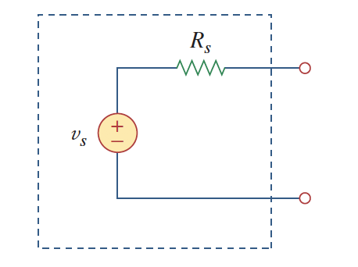
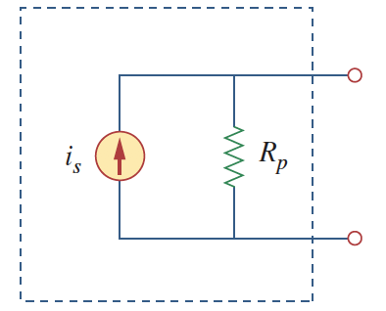
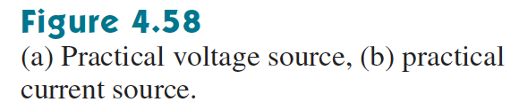
4.10 Uygulama 1:
Source modelling
  An ideal voltage source provides constant voltage independent of the load.
  An ideal current source provides constant current independent of the load.
  However, ideal sources does not exists.
  Practically all sources have internal resistances.

Slide 42



4.10 Uygulama 1:
Source modelling
  Practical Voltage Source:
  If Rs=0, the source becomes ideal source.
  If R_{L} is infinity (open circuit), Vs is the
  Unloaded source voltage.

Slide 43



4.10 Uygulama 1:
Source modelling
  Practical Current Source:
  If R_{L}=0, the source becomes ideal source.

Slide 44




4.10 Uygulama 1:
Source modelling
  How can we find R_{S} ( internal resistance) and V_{s} (unloaded source voltage)?
  First, measure the open circuit voltage,
  Then connect a variable resistor and tune the resistance until V_{L} = V_{S}/2. At that point R_{L}=R_{S}.

Slide 45

4.10 Uygulama 1:
Source modeling
  Example:

Slide 46

4.10 Uygulama 2:
Resistance measurement.
  Wheatstone Bridge.
    Wheatsone Bridges provides more accurate resistance measurement than Ohmmeters.

Slide 47

4.10 Uygulama 2:
Resistance measurement.
  Wheatstone Bridge.
    How does it operate:
      Tune the variable resistance until no current passes through the Galvanometer (balanced bridge).
      At this point v₁ = v₂.

Slide 48

4.10 Uygulama 2:
Resistance measurement.
  Wheatstone Bridge.
    How does it operate:
      Tune the variable resistance until no current passes through the Galvanometer (balanced bridge).
      At this point v₁ = v₂.

Slide 49
4.10 Uygulama 2:
Resistance measurement.
  Wheatstone Bridge.

Slide 50
4.10 Uygulama 2:
Resistance measurement.
  Wheatstone Bridge.

Slide 51

4.10 Uygulama 2:
Resistance measurement.
  Wheatstone Bridge.
  Hint: find V_{TH} and R_{TH} .
  Solve at home..

Slide 52
4.10 Uygulama 2:

Slide 53


Slide 54


Slide 55


Slide 56


Slide 57


Slide 58


Slide 59


Slide 61


