Slide 1
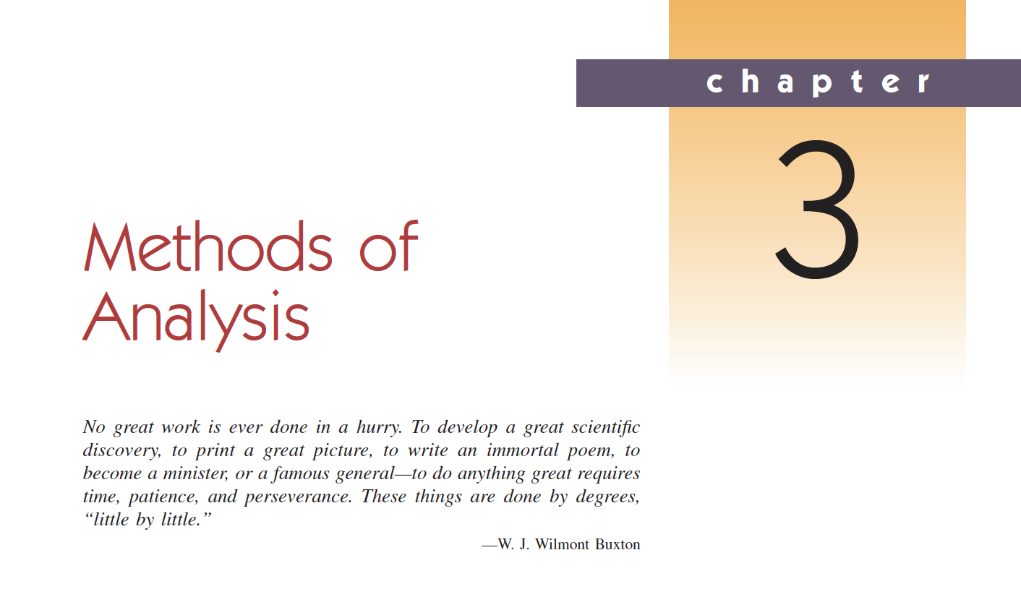

Slide 2
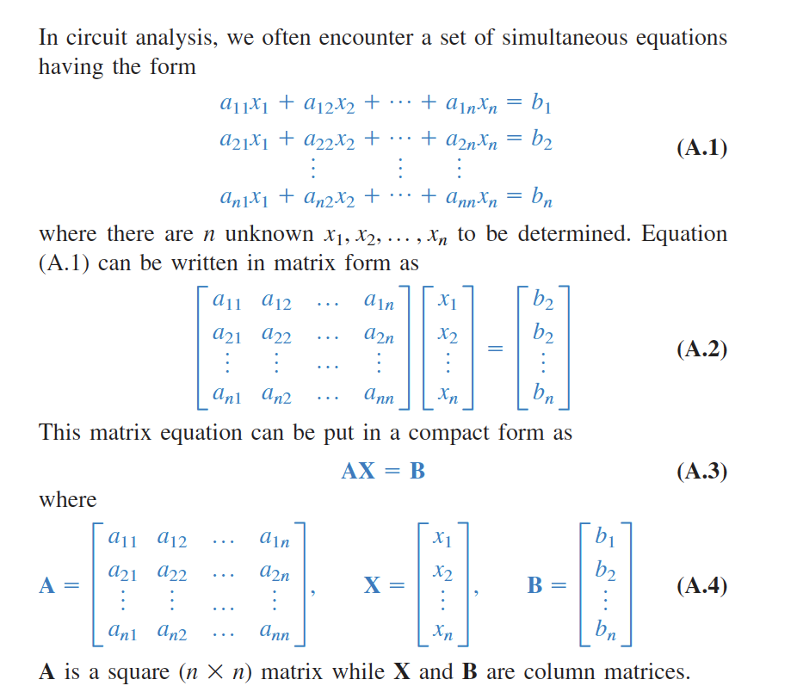
Bir miktar doğrusal cebir
Cramers’ rule:

Slide 3
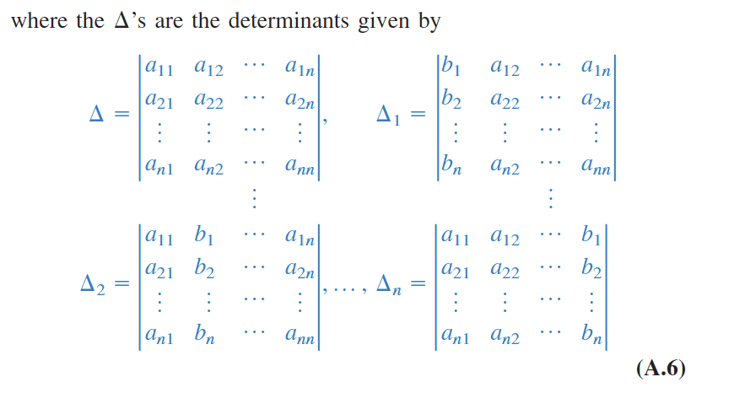
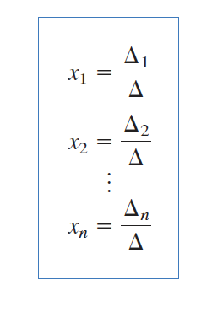
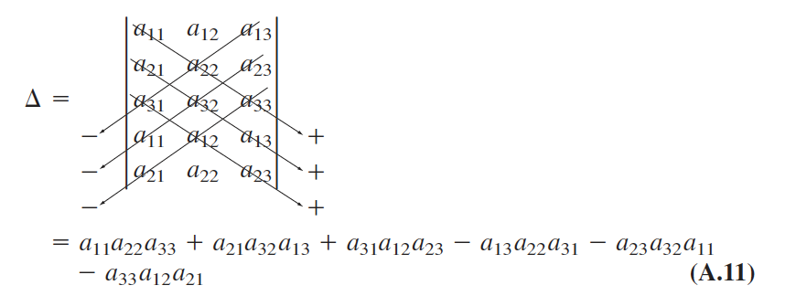
Bir miktar doğrusal cebir
Cramers’ rule:

Slide 4
Analiz Yöntemleri
There are two types of analysis
  1. Nodal analysis – uses Kirchhoff’s current law
    Düğüm-gerilim yöntemi
  2. Mesh Analysis – uses Kirchhoff’s voltage law
    Çevre-akım yöntemi

Slide 5
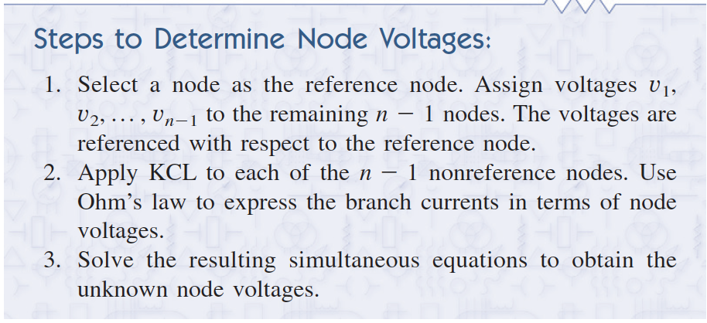
3.2 Düğüm Gerilim Yöntemi
In nodal analysis we are interested in finding the node voltages.

Slide 6
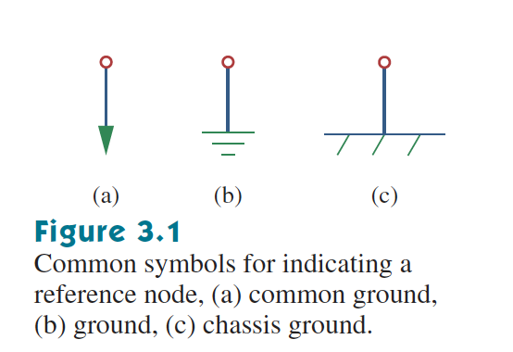
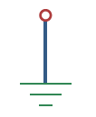
3.2 Düğüm Gerilim Yöntemi
Reference node:
  In this course we will use
The ground has zero voltage.

Slide 7
3.2 Düğüm Gerilim Yöntemi
Step by step:
  Assign 0 voltage to ground node,
  Assign voltages to other nodes,
  Assign currents to each component,
  Apply Kirchhoff Current Law (KCL),
  Apply Ohms’ law
  Arrange equations and generate the Matrix.

Slide 8
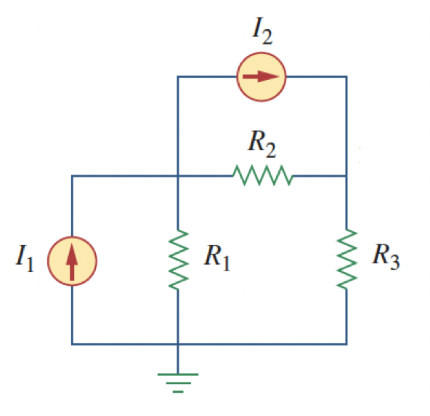
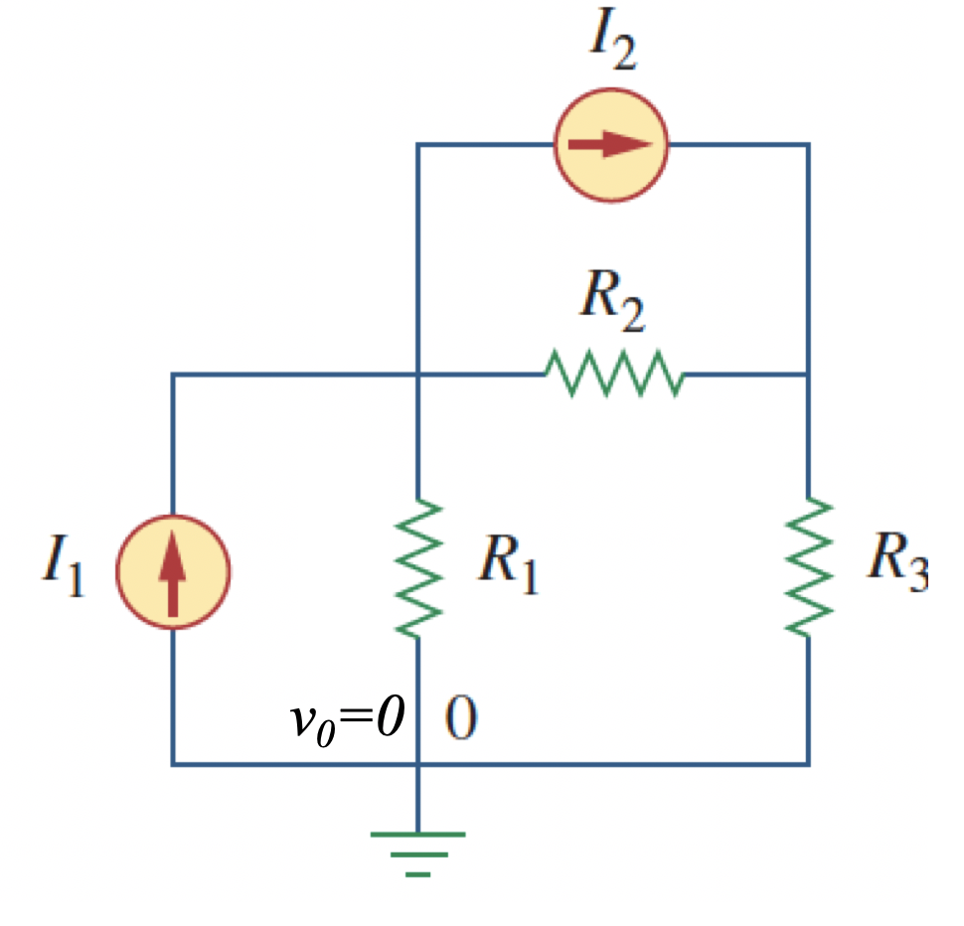
3.2 Düğüm Gerilim Yöntemi
Step by step:
  Assign 0 voltage to ground node,

Slide 9
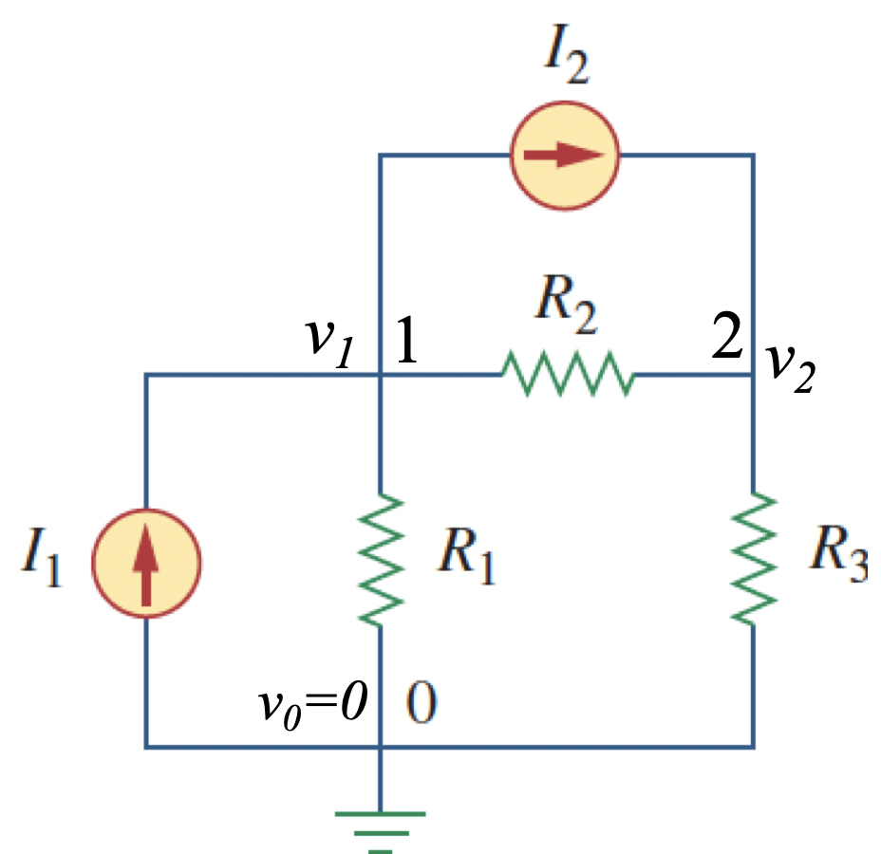
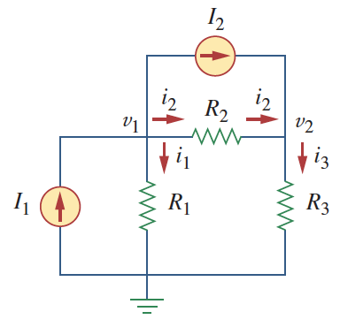
3.2 Düğüm Gerilim Yöntemi
Step by step:
  Assign 0 voltage to ground node,
  Assign voltages to other nodes,
  Assign currents to each component,

Slide 10
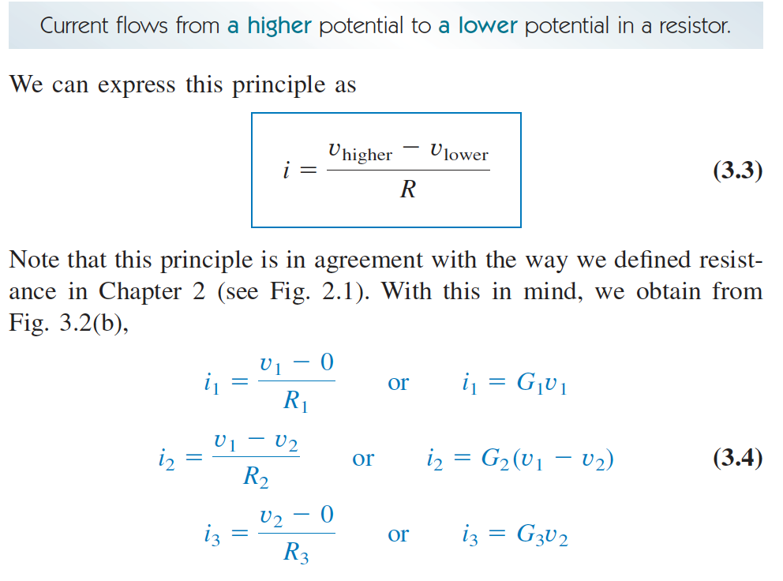
3.2 Düğüm Gerilim Yöntemi
Step by step:
  Assign 0 voltage to ground node,
  Assign voltages to other nodes,
  Assign currents to each component,
  Apply Kirchhoff Current Law (KCL),
  Apply Ohms’ law

Slide 11
3.2 Düğüm Gerilim Yöntemi
Step by step:
  Assign 0 voltage to ground node,
  Assign voltages to other nodes,
  Assign currents to each component (bence bu adıma gerek yok),
  Apply Kirchhoff Current Law (KCL),
  Apply Ohms’ law
  Arrange equations and generate the Matrix.

Slide 12
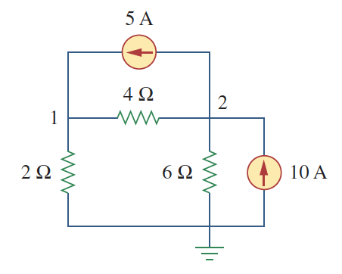
3.2 Düğüm Gerilim Yöntemi

Slide 13
3.2 Düğüm Gerilim Yöntemi

Slide 14
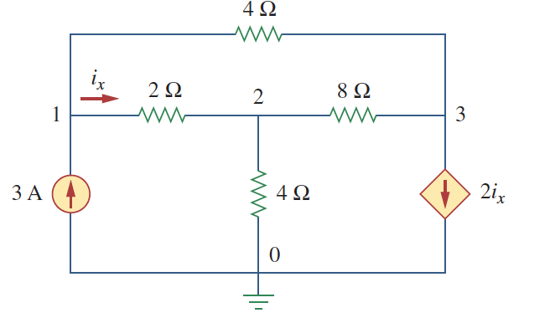
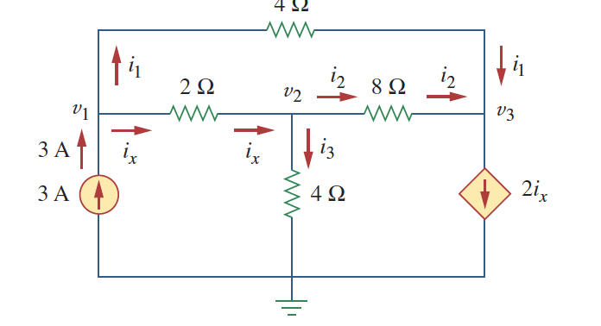
3.2 Düğüm Gerilim Yöntemi

Slide 16
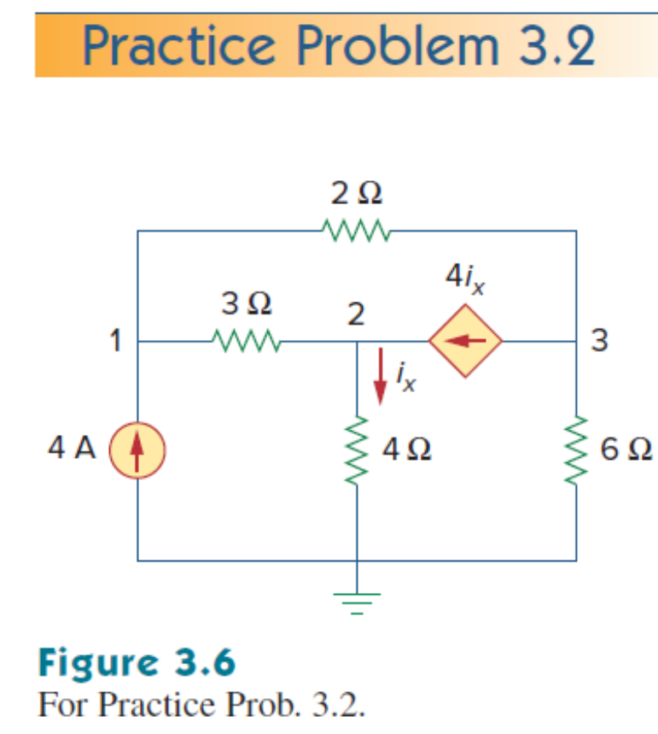
3.2 Düğüm Gerilim Yöntemi

Slide 18
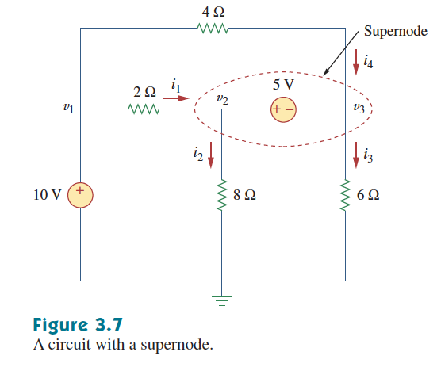

3.3 Süper Düğüm

Slide 19
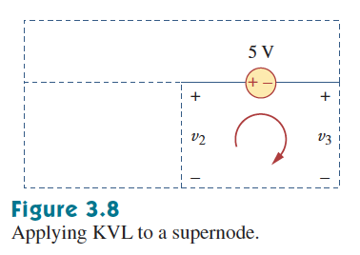
3.3 Süper Düğüm

Slide 20
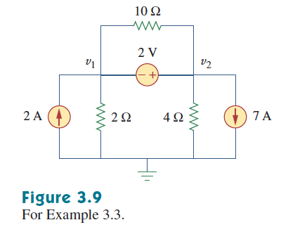
3.3 Süper Düğüm

Slide 22
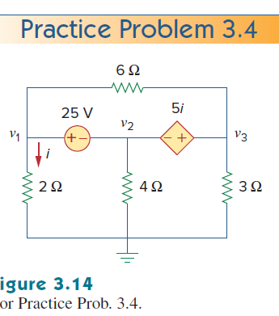
Nodal Analyses

Slide 24
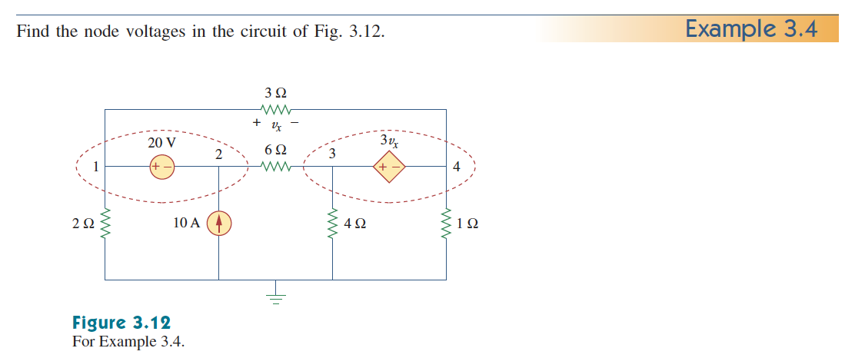
Nodal Analyses

Slide 25
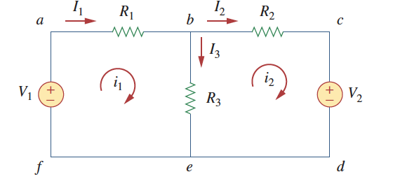
3.4 Çevre Akım Yöntemi
What is a Mesh ?
Show the meshes and loops in the upper circuit.

Slide 26
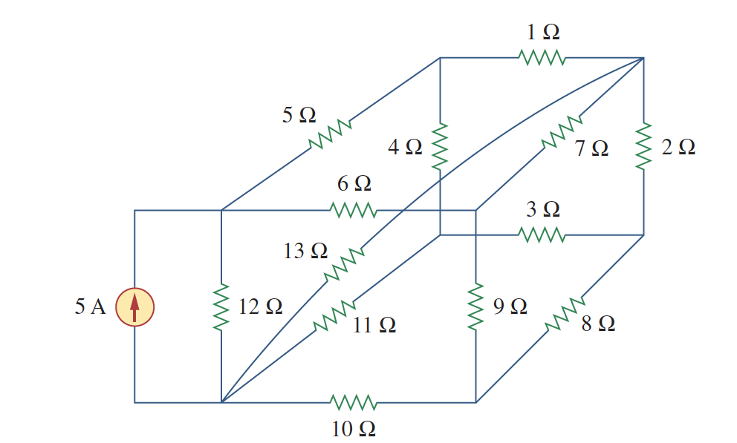
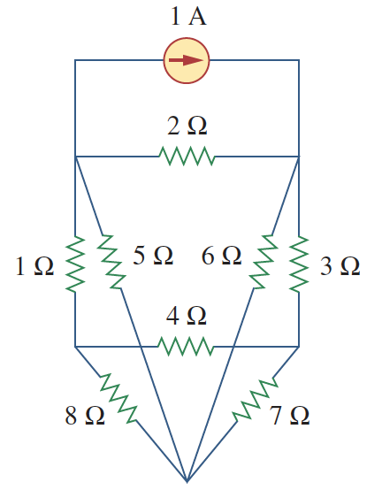
3.4 Çevre Akım Yöntemi
Mesh Analysis uses Kirchhoff Voltage Law (KVL)
Mesh Analysis is only applicable to planar circuits.
Planar or nonplanar?
Planar or nonplanar?

Slide 27
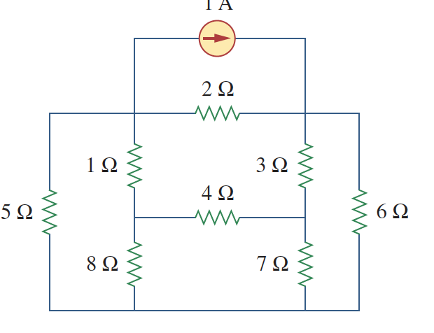
3.4 Çevre Akım Yöntemi
Mesh Analysis uses Kirchhoff Voltage Law (KVL)
Mesh Analysis is only applicable to planar circuits.

Slide 28
3.4 Çevre Akım Yöntemi
Step by step mesh analysis
  Assign mesh currents
  Apply KVL and Ohms’ Law to each mesh
  Solve the resulting n equations.

Slide 29
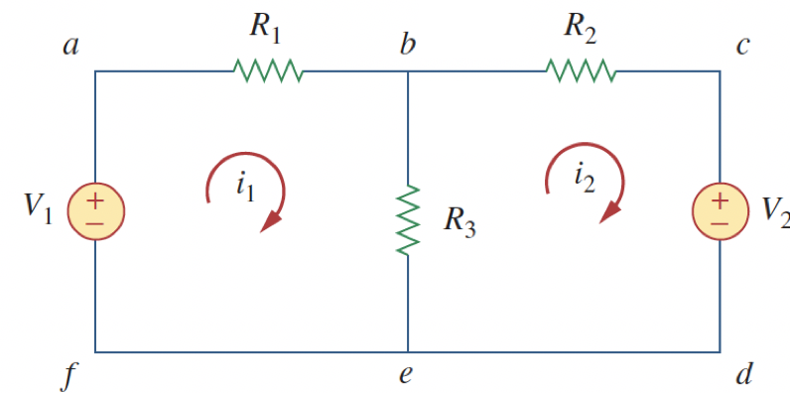
3.4 Çevre Akım Yöntemi
Step by step mesh analysis
  Assign mesh currents
  Apply KVL and Ohms’ law to each mesh
  Denklemleri yazalım (iki bilinmeyen iki denklem)

Slide 30
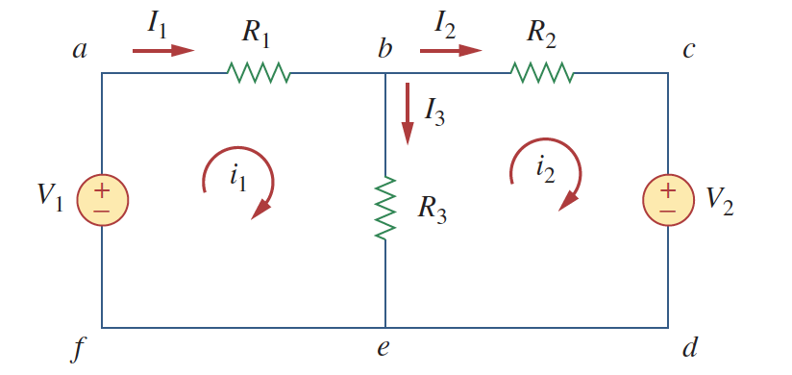
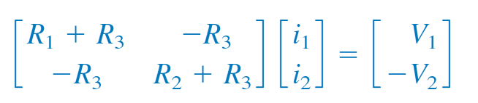

3.4 Çevre Akım Yöntemi
Step by step mesh analysis
  Assign mesh currents
  Apply KVL and Ohms’ law to each mesh
  Solve the resulting n equations

Slide 31
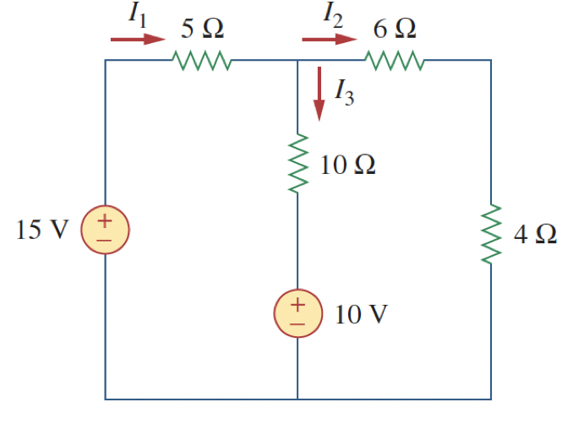

Slide 32
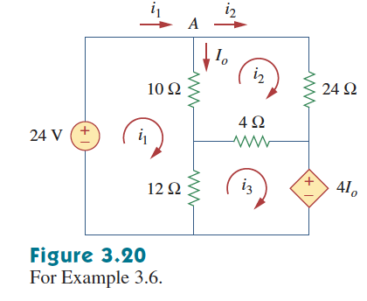

Slide 34
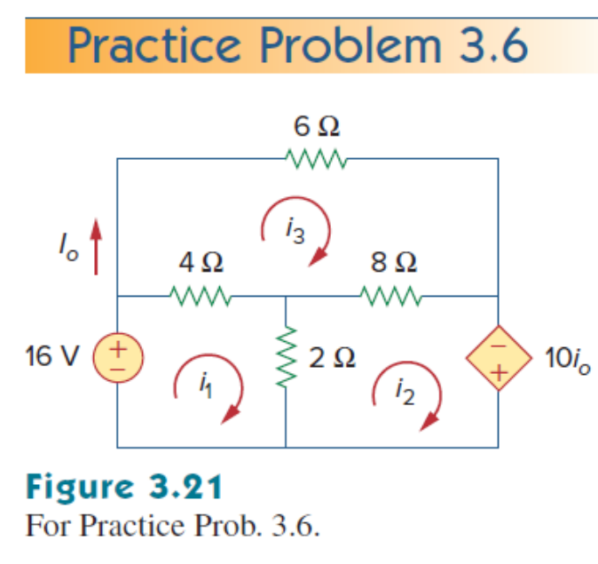

Slide 36

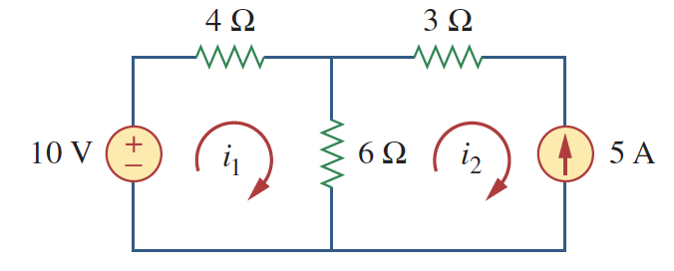
3.5 Süper Çevre
Current source exists in only one mesh.

Slide 37
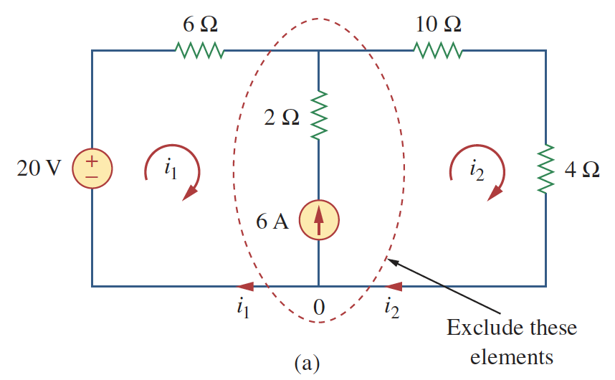
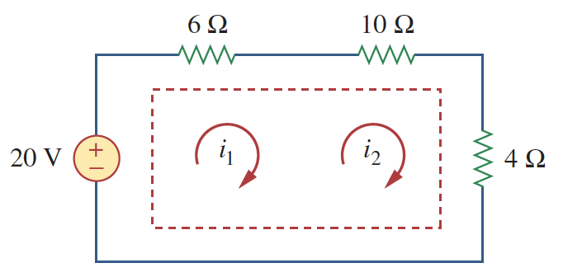
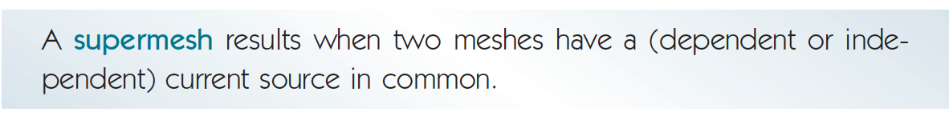
3.5 Süper Çevre
Current source exists between two meshes.

Slide 38
3.5 Süper Çevre
Current source exists between two meshes.

Slide 39
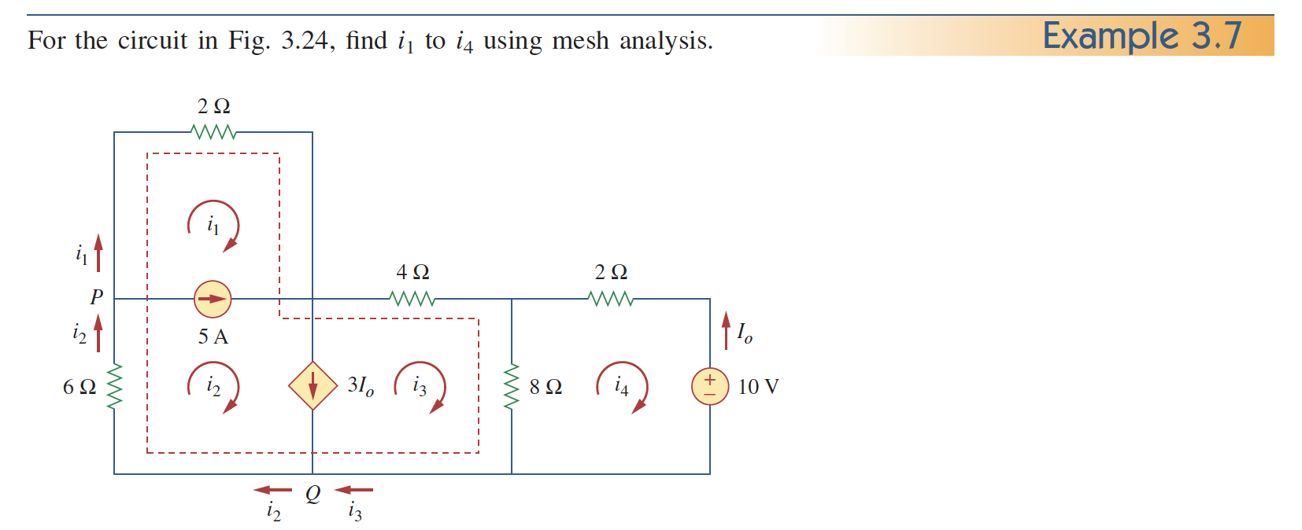
3.5 Mesh Analysis with Current Source

Slide 41
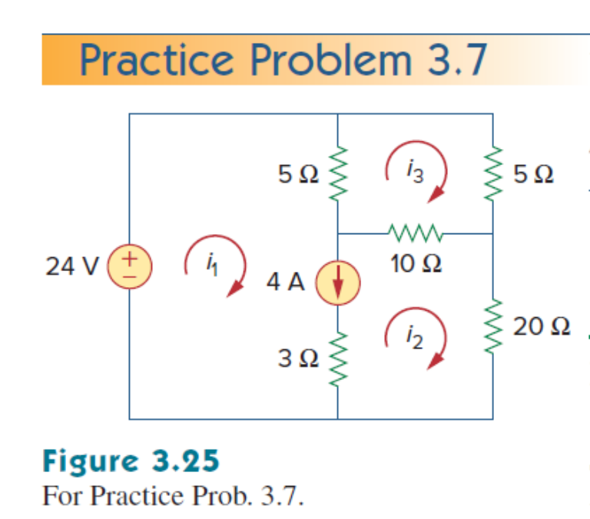

Slide 43
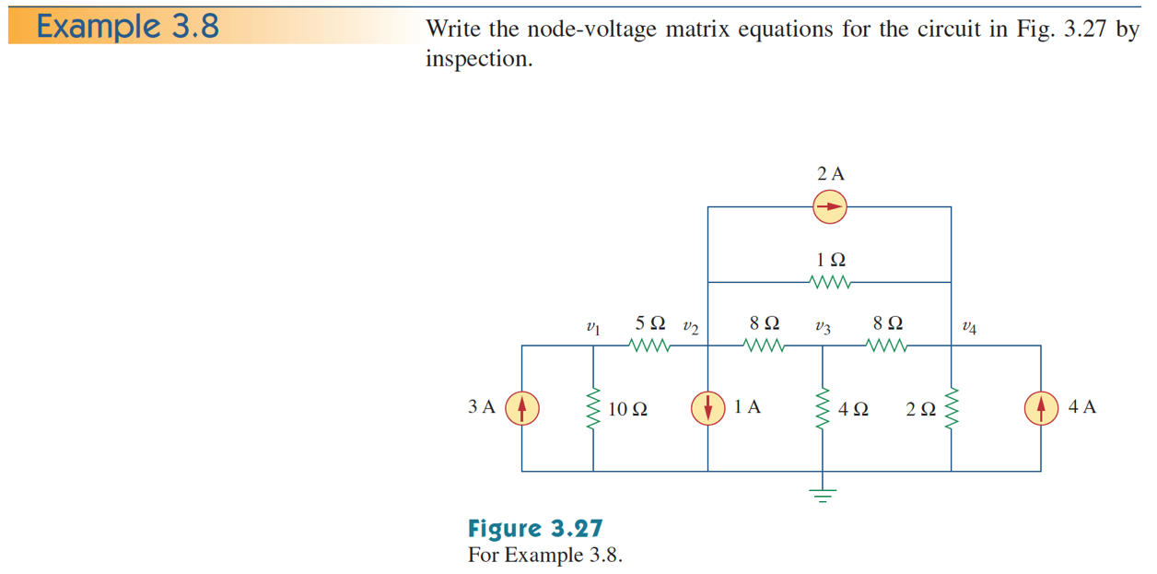

Slide 46
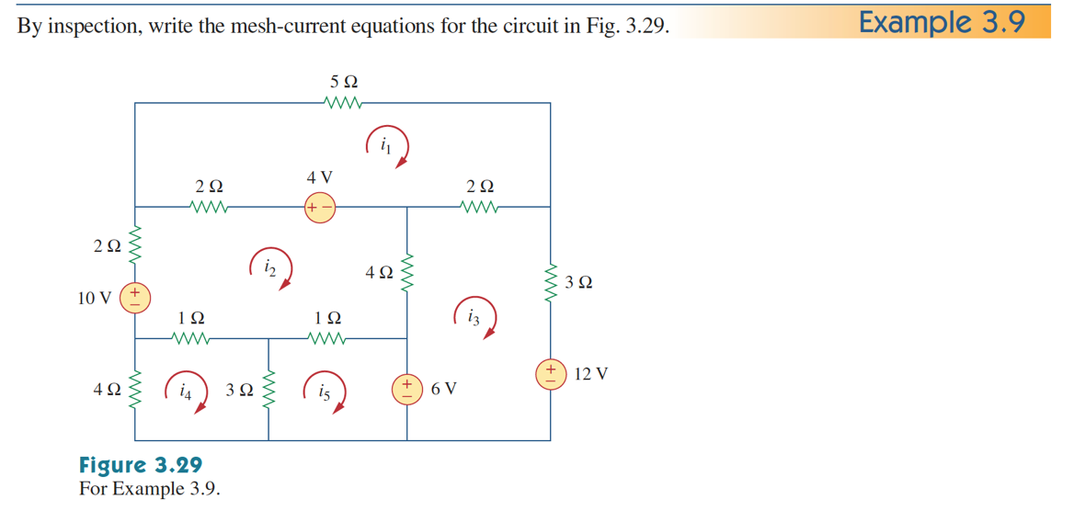

Slide 48
DGY ve ÇAY arasında tercih
In principle both the nodal analysis and mesh analysis are useful for any given circuit.
What then determines if one is going to be more efficient for solving a circuit problem?
There are two factors that dictate the best choice:
  The nature of the particular network is the first factor
  The second factor is the information required

Slide 49
ÇAY tercih etmek için…
If the network contains:
  Many series connected elements
  Voltage sources
  Supermeshes
  A circuit with fewer meshes than nodes
If branch or mesh currents are what is being solved for.
Mesh analysis is the only suitable analysis for transistor circuits
It is not appropriate for operational amplifiers because there is no direct way to obtain the voltage across an op-amp.

Slide 50
DGY tercih etmek için
If the network contains:
  Many parallel connected elements
  Current sources
  Supernodes
  Circuits with fewer nodes than meshes
If node voltages are what are being solved for
Non-planar circuits can only be solved using nodal analysis
This format is easier to solve by computer

Slide 51
3.9 DC Transistor Circuits
Bu konuyu ele 224 dersinde göreceğiz, o nedenle şimdi görmemizin bir anlamı yok
Uygulama

Slide 52
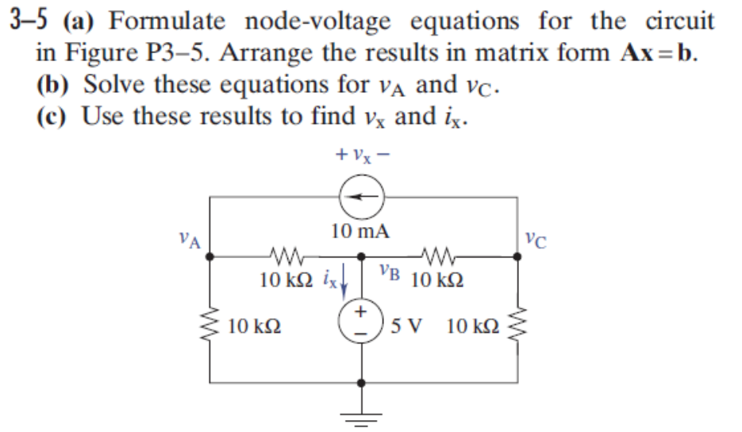

Slide 53
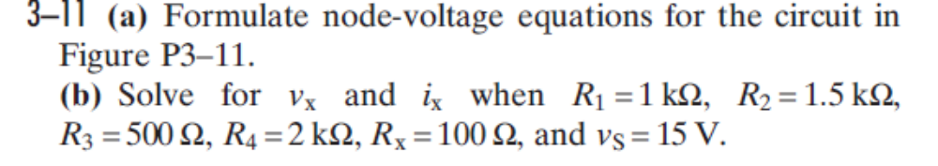
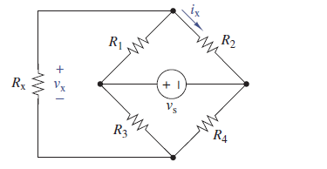

Slide 54
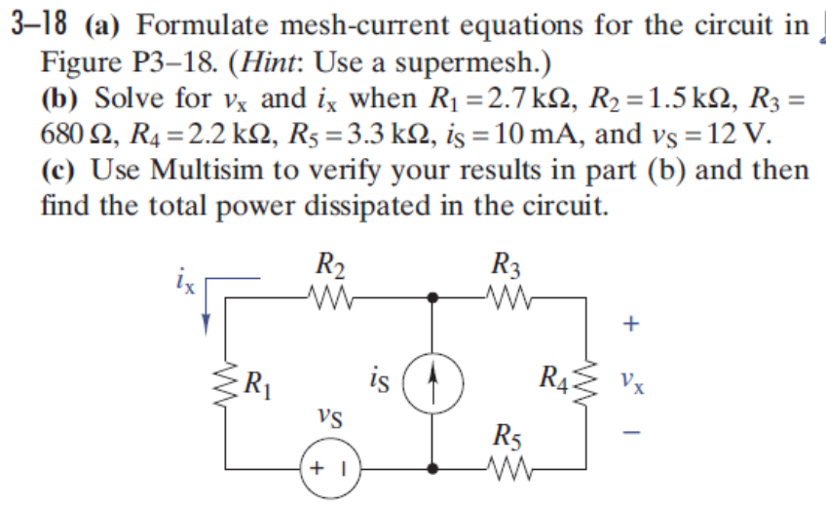

Slide 55
