Slide 1
CHAPTER 2
Temel KANUNLar

Slide 2
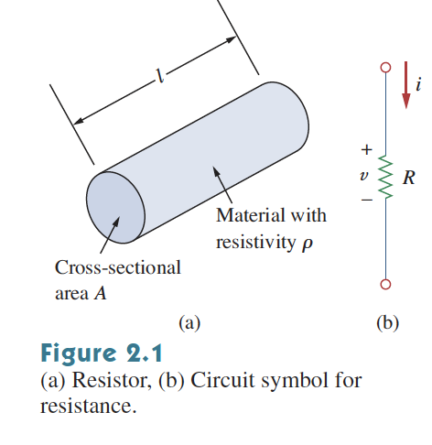

2.2 Ohm Kanunu
Resistance: The ability to resist current.

Slide 3
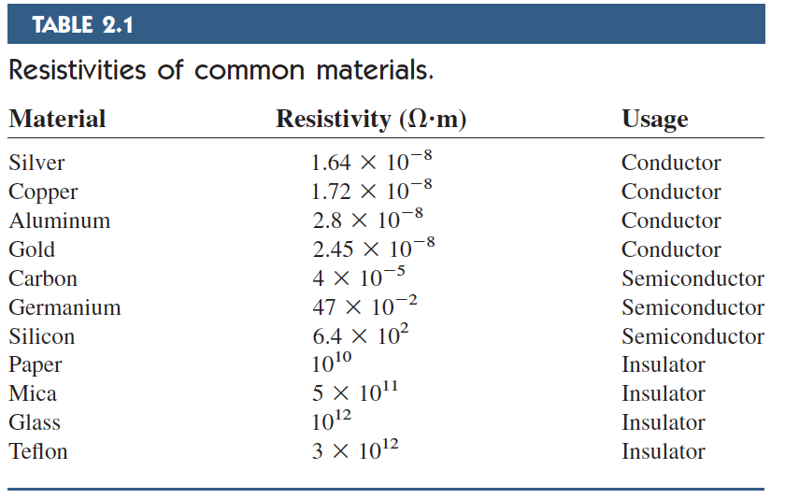
2.2 Ohm Kanunu
Resistance: The ability to resist current.
Metal alaşım ve karbon bileşiklerinden imal edilir

Slide 4

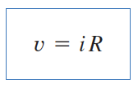
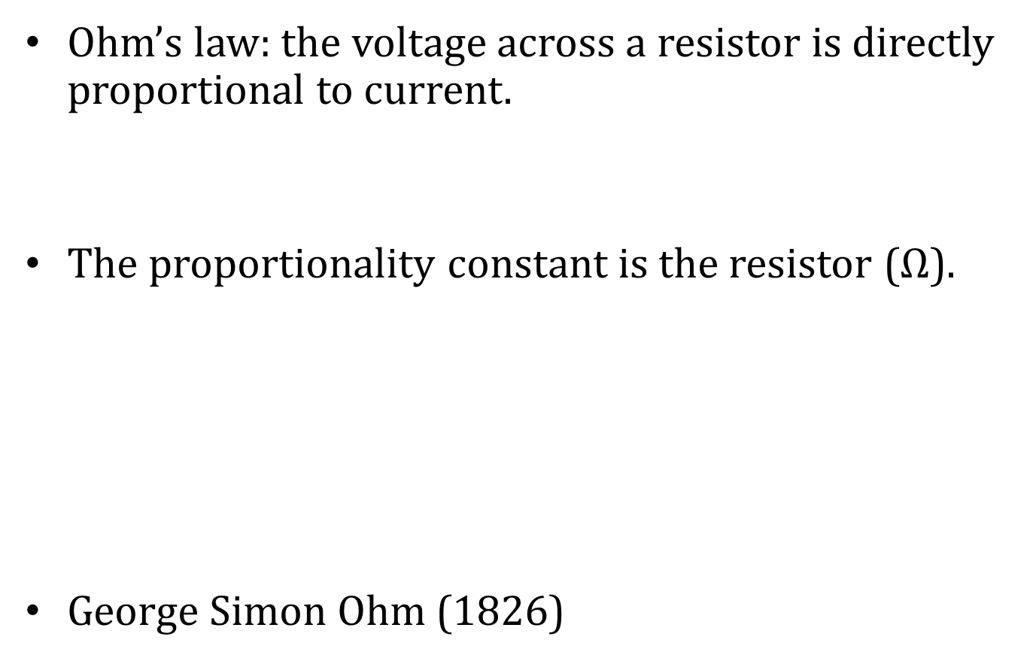
2.2 Ohm Kanunu
Ohm’s law: the voltage across a resistor is directly proportional to current.
The proportionality constant is the resistor ($Ω$).
George Simon Ohm (1826)

Slide 5
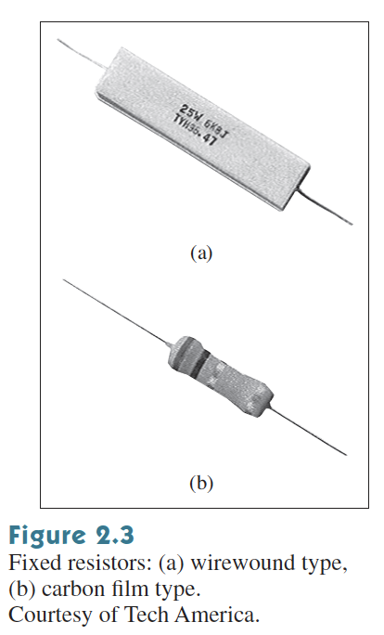
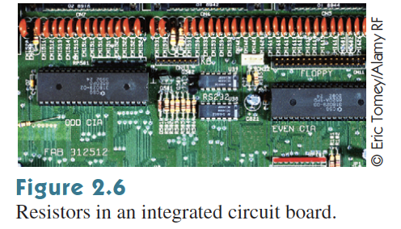
2.2 Ohm Kanunu
Resistor.

Slide 6
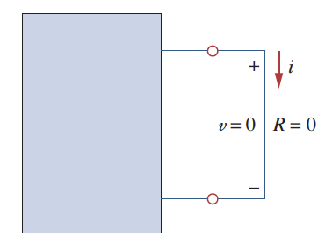
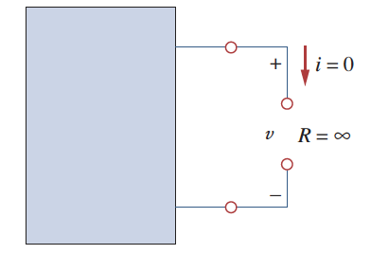
2.2 Ohm Kanunu
A short circuit is a circuit element with resistance approaching zero.
An open circuit is a circuit element with resistance approaching to infinity.

Slide 7
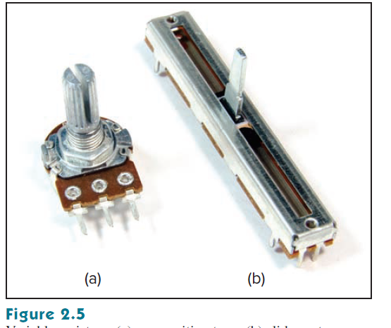
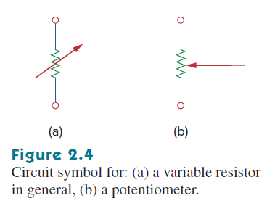
2.2 Ohm Kanunu
Sabit dirençler
Değişken dirençler (Potansiyometre - POT)

Slide 8
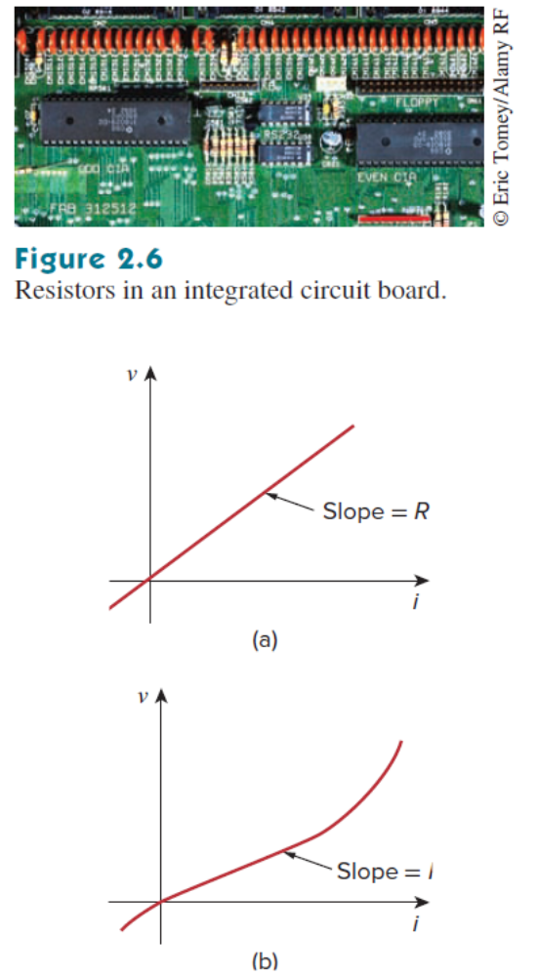
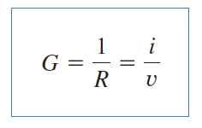
2.2 Ohm Kanunu
Conductance is the ability of an element to conduct electric current (S - Siemens).
Dirençte harcanan güç?

Slide 9
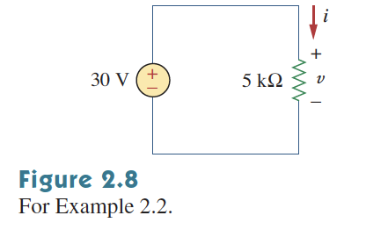
2.2 Ohm Kanunu
Example: Calculate the current, conductance and the power in the circuit below:

Slide 10
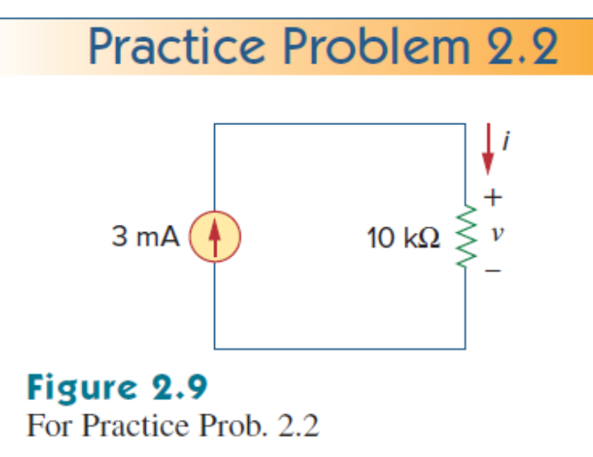

Slide 11
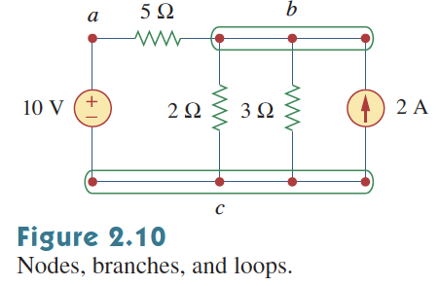
2.3 Dallar, düğümler ve çevreler
Branch is a two terminal element (bir elemanı temsil eder).
  In the below network there are 5 branches
    10 V voltage source, 2 A current source, 3 resistors

Slide 12
2.3 Dallar, düğümler ve çevreler
Nodes is the connection between branches.
  In the below network there are 3 nodes.
    a, b and c.

Slide 13
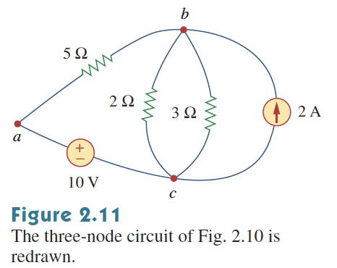
2.3 Dallar, düğümler ve çevreler
Nodes is the connection between branches.
  In the below network there are 3 nodes.
    a, b and c.

Slide 14
2.3 Dallar, düğümler ve çevreler
A loop is a closed path in a circuit.
  In the below network there are 3 loops.
b=l+n-1

Slide 15
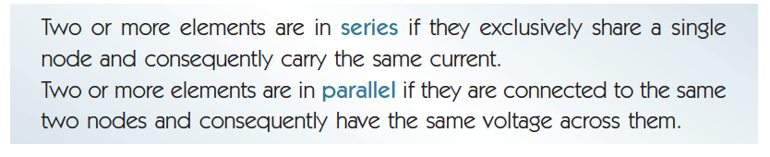
2.3 Dallar, düğümler ve çevreler
How many parallel and serial elements are there in the circuit below:

Slide 16
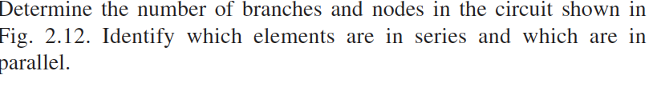
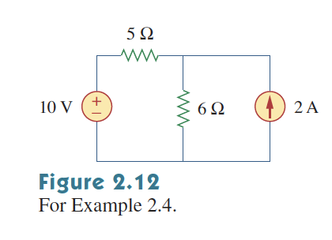
2.3 Dallar, düğümler ve çevreler

Slide 17
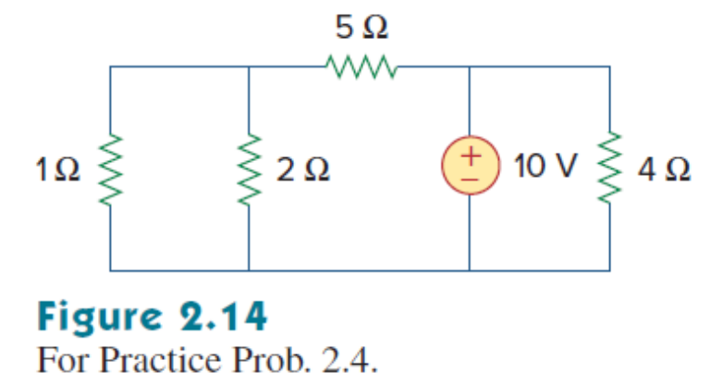
2.3 Dallar, düğümler ve çevreler

Slide 18
2.4 Kırchhoff’s law

Slide 19
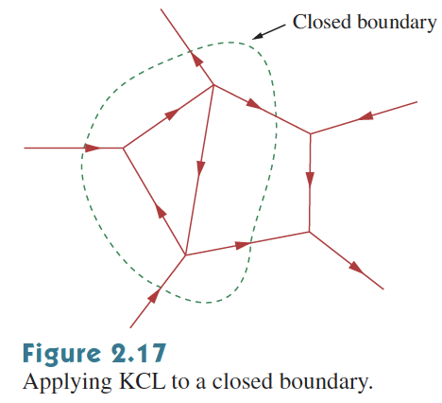
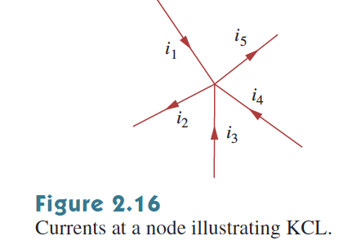
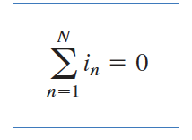
2.4 Kirchhoff Kanunu
Kirchhoff’s Current Law (KCL): The sum of currents entering a node (or closed boundary) is zero.

Slide 20
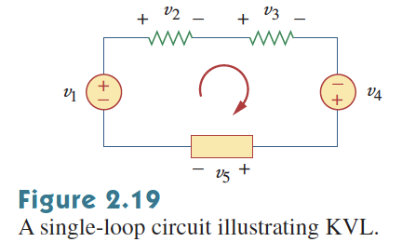

2.4 Kirchhoff Kanunu
Kirchhoff’s voltage law: The algebraic sum of all voltages around a closed path (or loop) is zero.

Slide 21
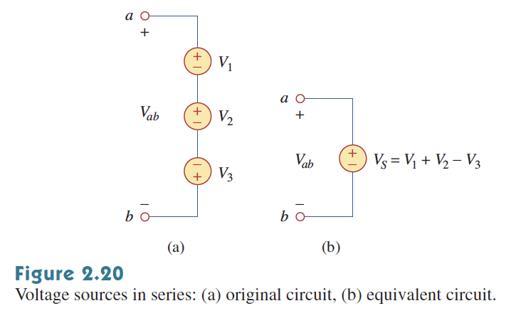
2.4 Kirchhoff Kanunu

Slide 22
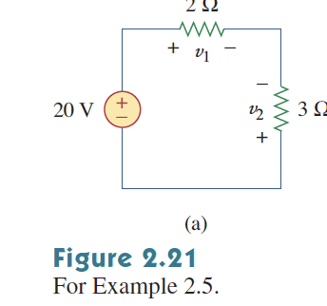
2.4 Kirchhoff Kanunu
Example: Find voltages V1 and V2.

Slide 23
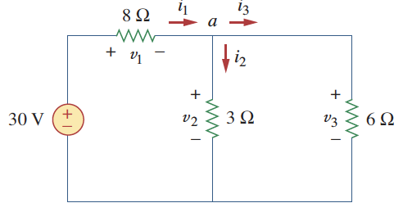
2.4 Kirchhoff Kanunu
Example: Find currents and the voltages in the circuit below:

Slide 24
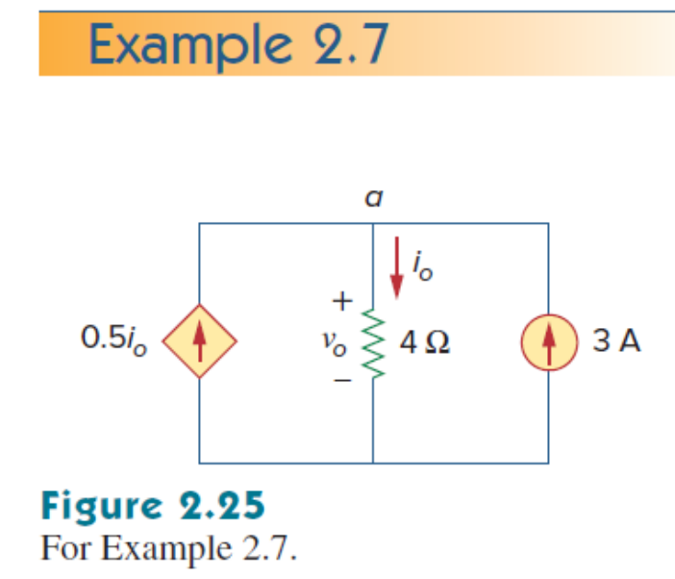
2.4

Slide 25
2.5 SeRİ VE PARALEL BAĞLI DİRENÇLER

Slide 26
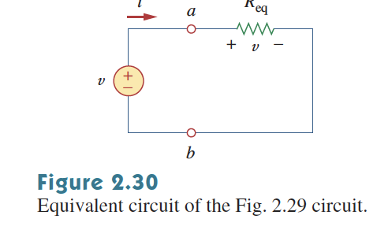
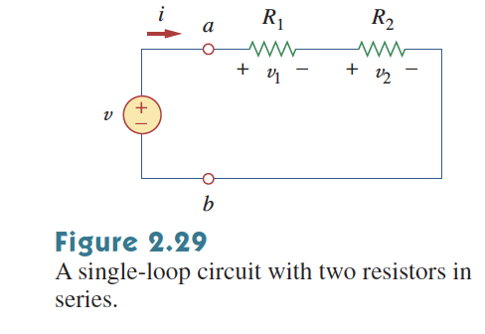
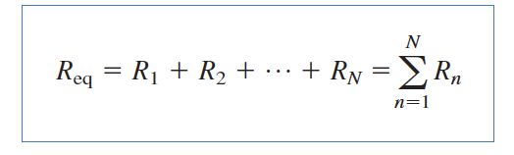
2.5 Seri Bağlı Dirençler
Series Resistors:

Slide 27
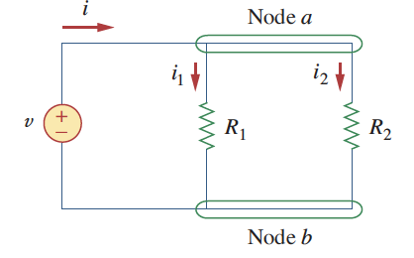
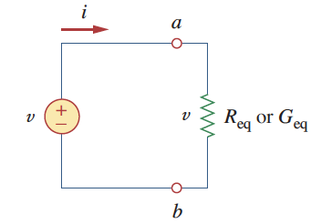
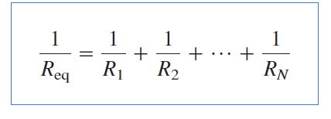
2.6 Paralel Bağlı Dirençler
Parallel Resistors:

Slide 28
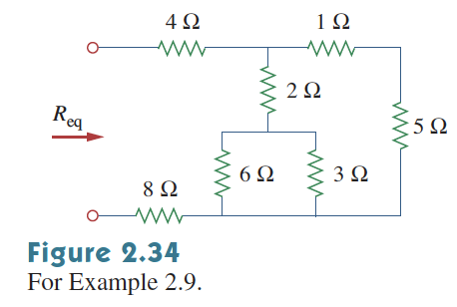
2.6 Paralel Bağlı Dirençler
Find the equivalent resistance in the circuit below:

Slide 29
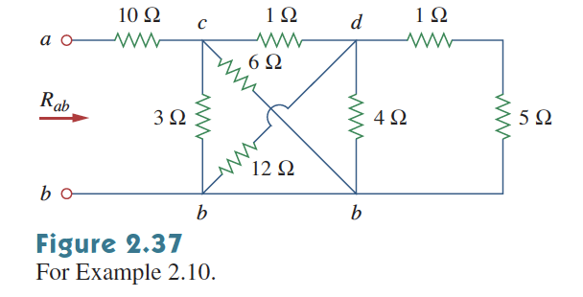
Seri-Paralel Bağlı Dirençler
Find the equivalent resistance in the circuit below:

Slide 30
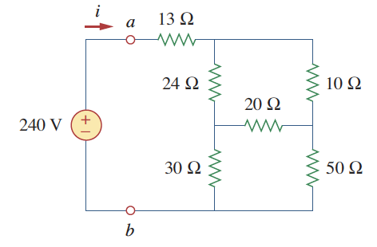
Seri-Paralel Bağlı Dirençler
Find the equivalent resistance in the circuit below:

Slide 31
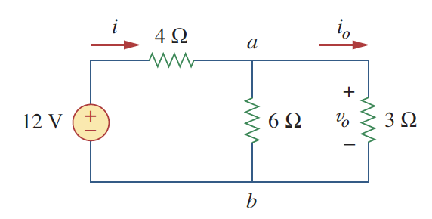
Seri-Paralel Bağlı Dirençler
Find i₀ and v₀ in the circuit below:

Slide 32
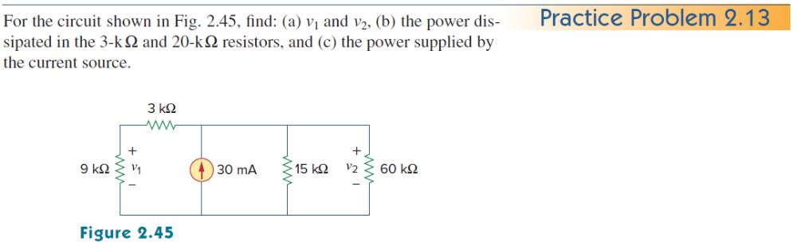

Slide 33
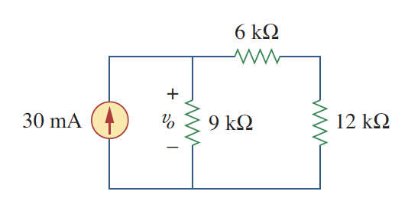
Seri-Paralel Bağlı Dirençler
Find v₀ and the power supplied by the current source in the circuit below:

Slide 34
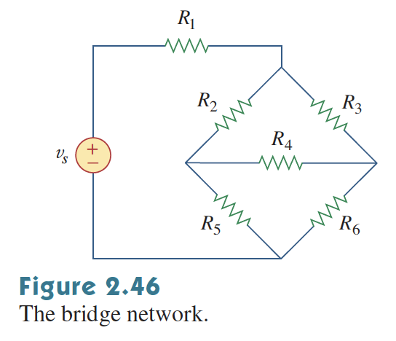
2.7 Wye-Delta Dönüşümü
Bridge Circuit, neither parallel nor series.

Slide 35
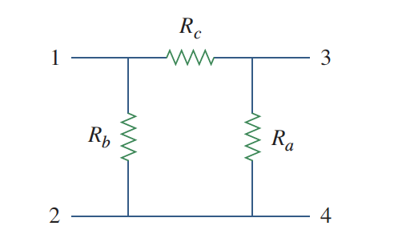
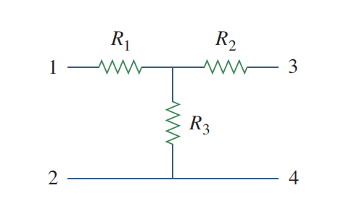
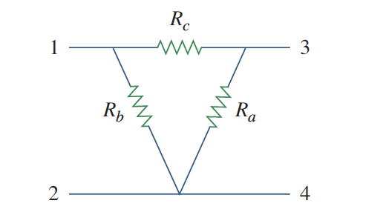
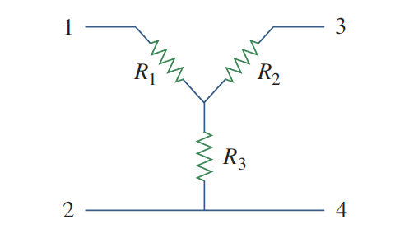
2.7 Wye-Delta Dönüşümü
Delta to Wye conversion
  Pi veya Delta, aynı
  Y veya T, aynı

Slide 36
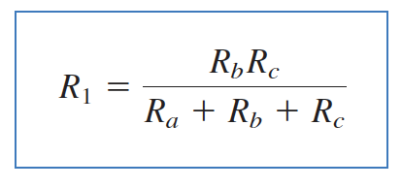
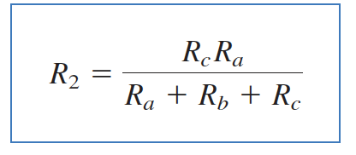
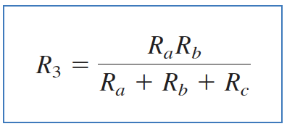
2.7 Wye-Delta Dönüşümü
Delta to Wye conversion

Slide 37
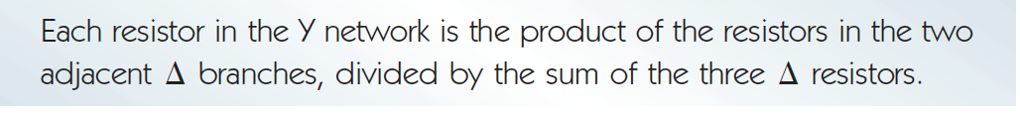
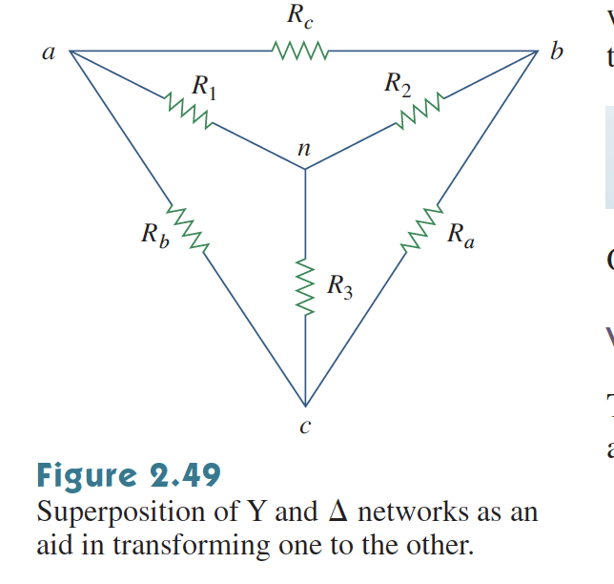
2.7 Wye-Delta Dönüşümü
Delta to Wye conversion (Simplified)

Slide 38



2.7 Wye-Delta Dönüşümü
Wye to Delta conversion

Slide 39

2.7 Wye-Delta Dönüşümü
Wye to Delta conversion

Slide 40

2.7 Wye-Delta Dönüşümü

Slide 41

2.7 Wye-Delta Dönüşümü

Slide 42

2.7 Wye-Delta Dönüşümü
Find the equivalent resistance between a and b.

Slide 43

2.7 Wye-Delta Dönüşümü
There are 3 parallel resistors

Slide 44


DC Metre
Potentiometer (Potential meter) - pot: A device that controls the voltage, voltage regulator:

Slide 45

DC Metre
Voltmeter (voltage meter)
Ammeter (ampere meter)
Ohmmeter (resistance meter)

Slide 46


DC Metre
All these meters depends on d’Arsonval meter
  This device measures current (if one knows the current and another parameter the third one can be found)
Remember: Lorentz Force

Slide 47


DC Metre
Voltmeters require high resistance (as high as possible):

Slide 48

DC Metre
Ammeter requires low resistance (as low as possible):

Slide 49

DC Metre
Ohmmeter (uses voltmeter and ammeter):

Slide 50


Slide 51


Slide 52


Slide 53


Slide 54


Slide 55


Slide 56


Slide 57


Slide 58


Slide 60
SON

