Slide 1
Lecturer: Prof. Dr. Tolga Girici
Email: tgirici@etu.edu.tr

Slide 2
Circuit elements

Slide 3
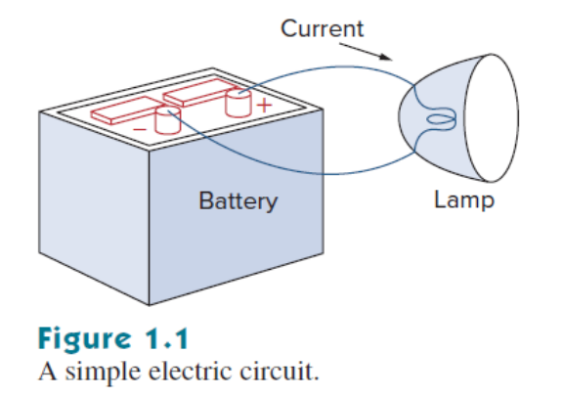
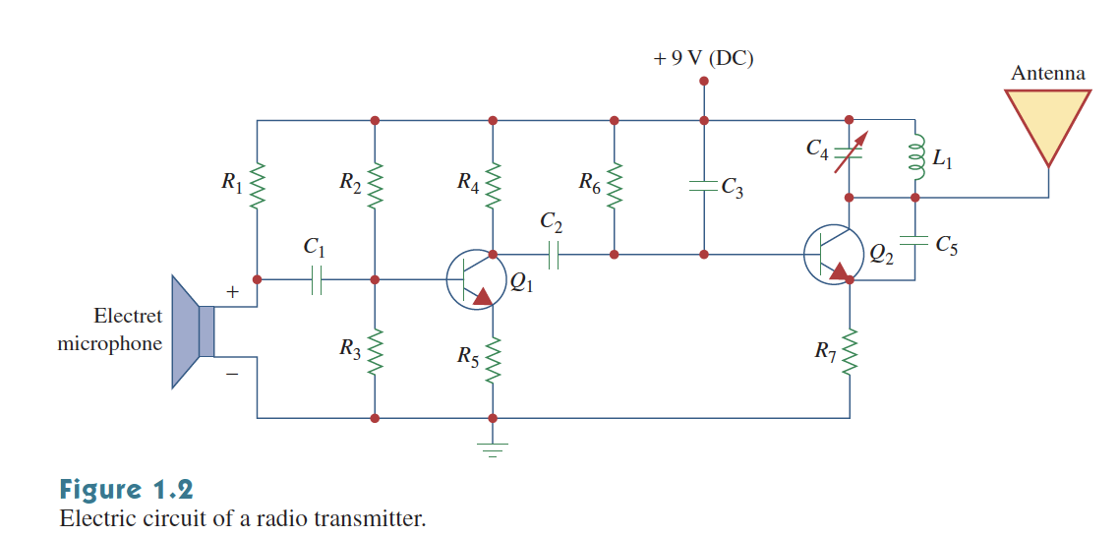
Circuit
An electrical circuit is an interconnection of electrical elements
element

Slide 4
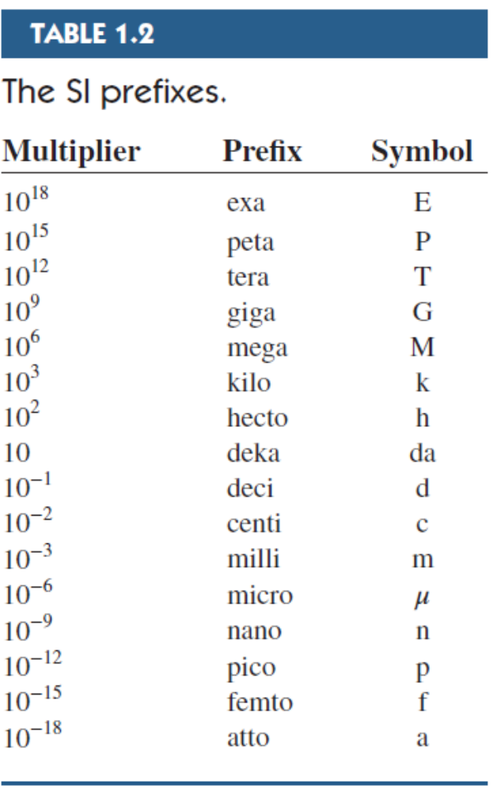
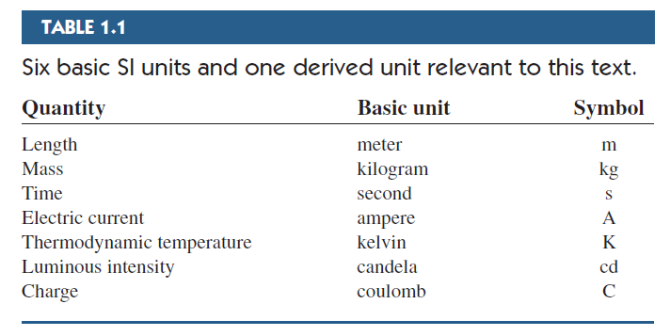
1.2 Birimler

Slide 5
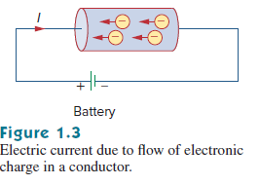
1.3 Yük ve Akım
Yük
Elektron
Proton
Akım

Slide 6
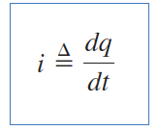
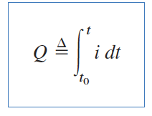
1.3 Yük ve Akım
Electric current is the time rate of change of charge. (A)
The amount of charge that passes through a point between time t₀ and t is (C):

Slide 7
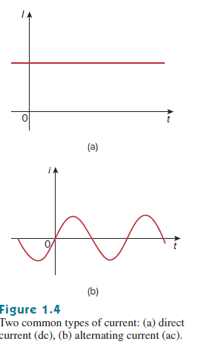
1.3 Yük ve Akım
Doğru akım
Alternatif akım

Slide 8
Örnekler:
Example 1.1 How much charge is represented by 4,600 electrons?
Practice Problem 1.1: Calculate the amount of charge represented by 6.667 billion protons.
Example 1.2 The total charge entering a terminal is given by q = 5t sin 4πt mC. Calculate the current at t = 0.5 s.

Slide 9

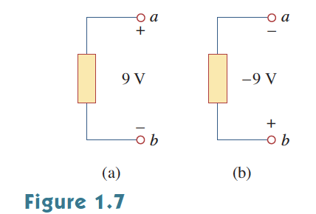

1.4 Gerilim (Voltaj)
Voltage (potential difference) is the required energy to move a unit of charge between two points (V).
Voltage is always defined for two points.

Slide 10
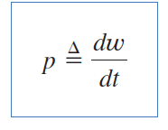
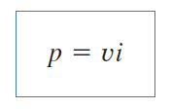
1.5 Güç ve Enerji
Power is the time rate of change of energy (W),
Show that :

Slide 11
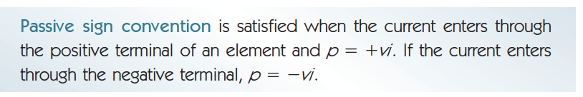
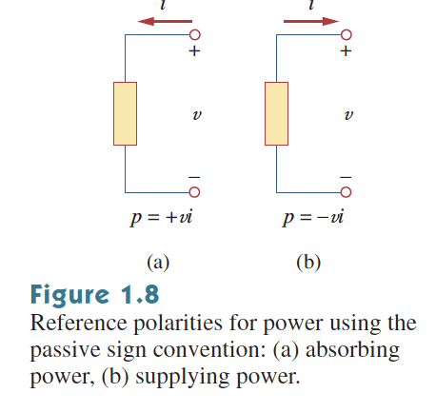
1.5 Güç ve Enerji
If the power is negative then the element is supplying power (ex: battery)
If it is positive than the element is consuming power (ex: resistor)

Slide 12

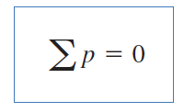
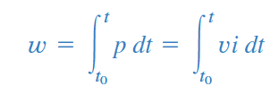
1.5 Güç ve Enerji
Energy is the total amount of work done in a time interval.

Slide 13
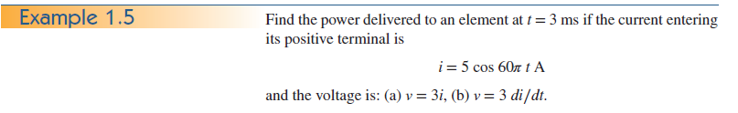
Örnekler

Slide 14
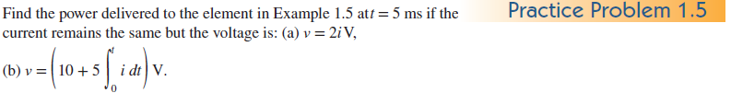
Örnekler

Slide 15
1.6 Circuit elements
Elektrik devresi devre elemanlarının çeşitli şekillerde bağlanması ile oluşur
There are two types of elements
  Active elements: Elements that generate energy
    Generators, batteries, amplifiers
  Passive elements: Elements that don’t generate energy
    Resistors, capacitors, inductors

Slide 16
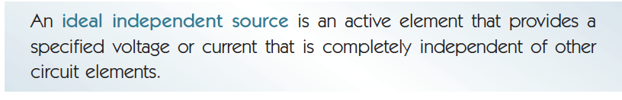
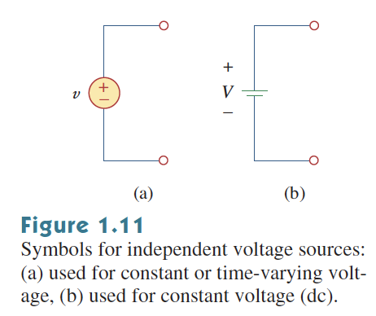
1.6 Circuit elements
The source (energy source): The active element that generally deliver power to the circuit.
DC or Time varying
voltage source
DC voltage source

Slide 17

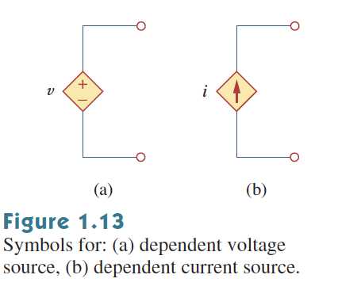
1.6 Circuit elements
The source (energy source): The active element that generally deliver power to the circuit.
Dependent sources are designated by a diamond shape.
Keep in mind that a voltage source comes with +- polarities whereas a current source with an arrow

Slide 18
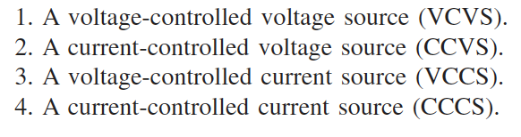
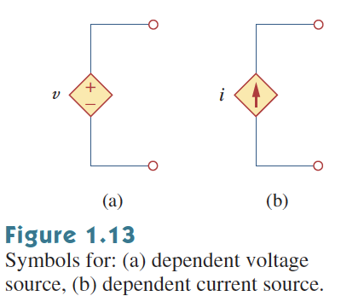
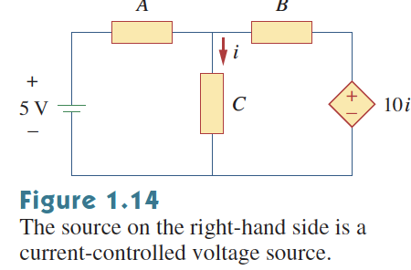
1.6 Circuit elements
The dependent sources are divided in to 4 categories:
What type
of a source is that ?

Slide 19
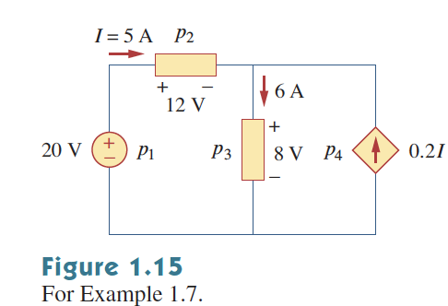
1.6 Circuit Elements
Example: Calculate the power supplied or absorbed by each element.

Slide 20
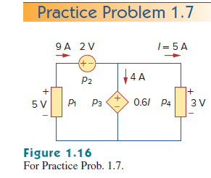
1.6 Circuit Elements
Example: Calculate the power supplied or absorbed by each element.

Slide 21
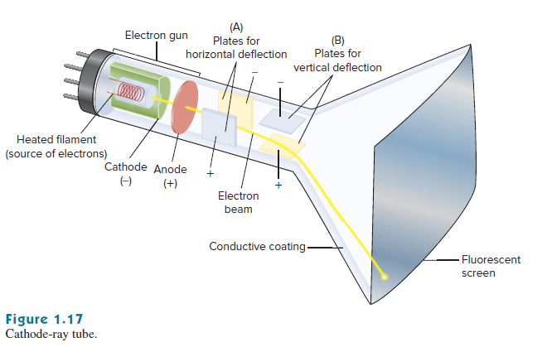
1.7 Uygulamalar
Cathode Ray Tube (CRT)
  Karl Ferdinand Barun (1879)
  Vladimir Zworykin

Slide 22
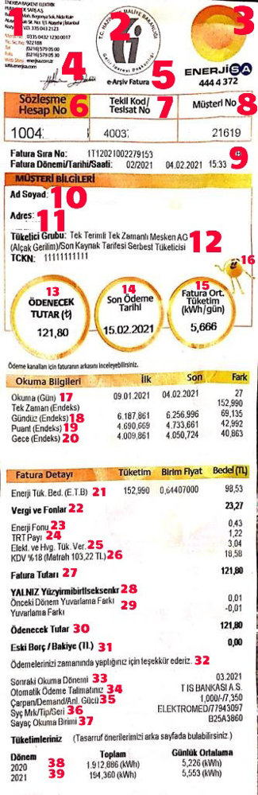
https://solaravm.com/elektrik-faturasi-nasil-hesaplanir

Slide 23
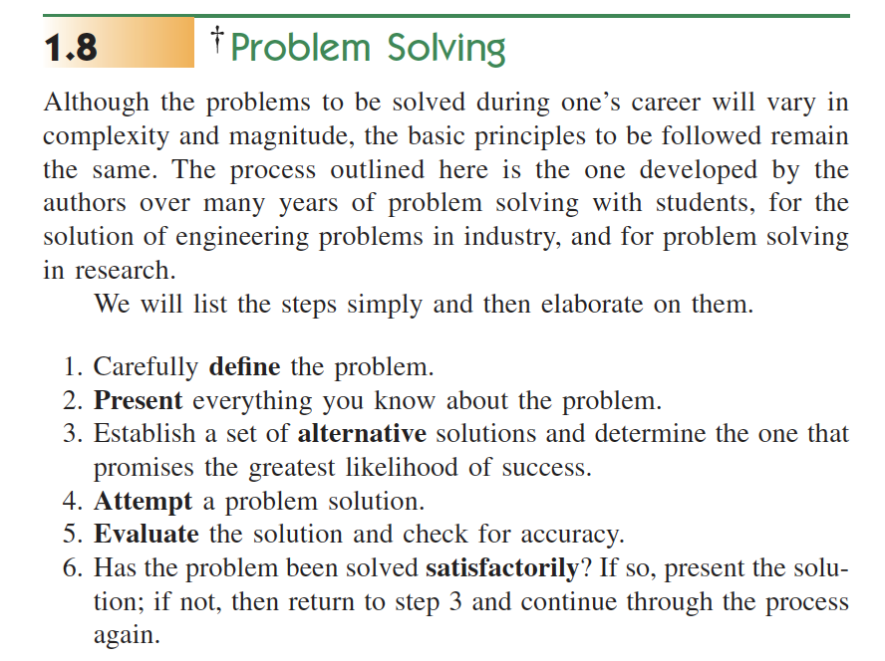
Electrical Circuits
READ SECTION 1.8 CAREULLY !!

Slide 24
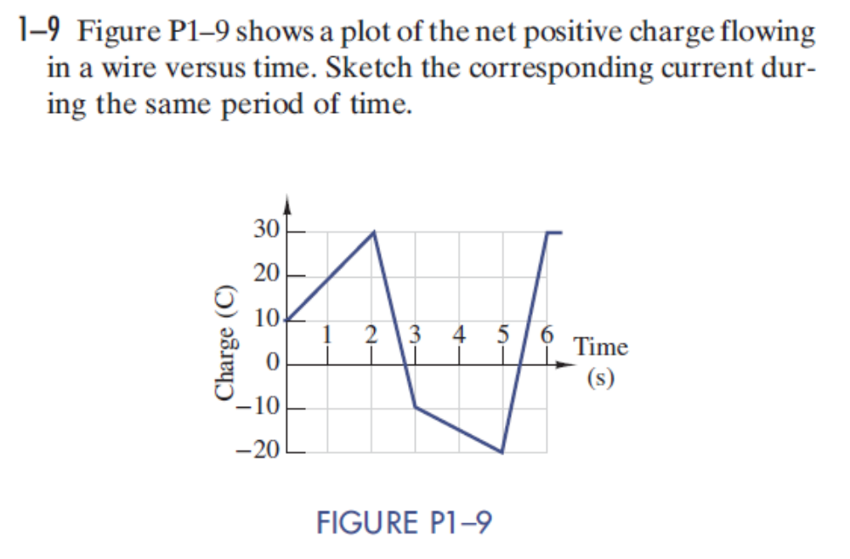

Slide 25
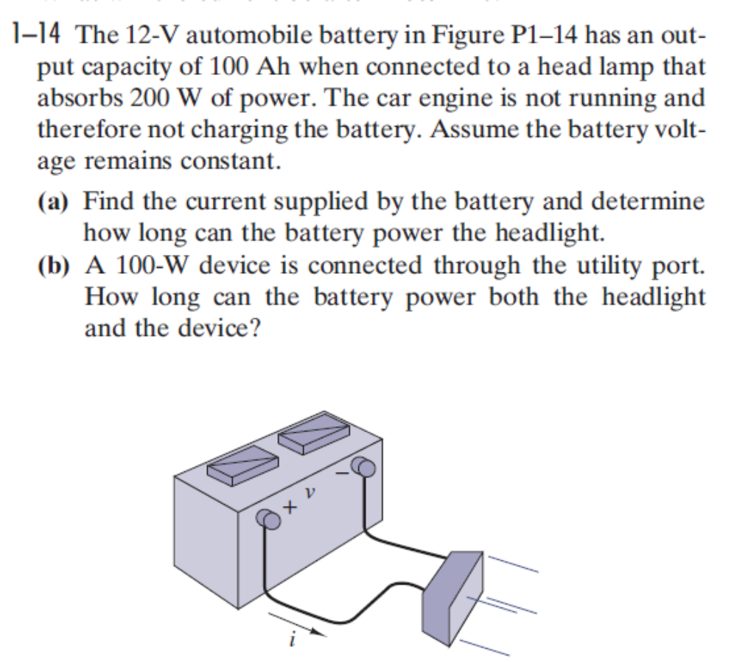

Slide 26
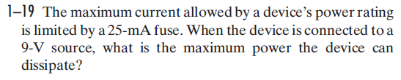

Slide 27
